Slide 1
Data and Signals 数据和信号
中地大计算机学院
陈喆
E_Mail: chenzhe@cug.edu.cn
Tel: 13035110088

Slide 2
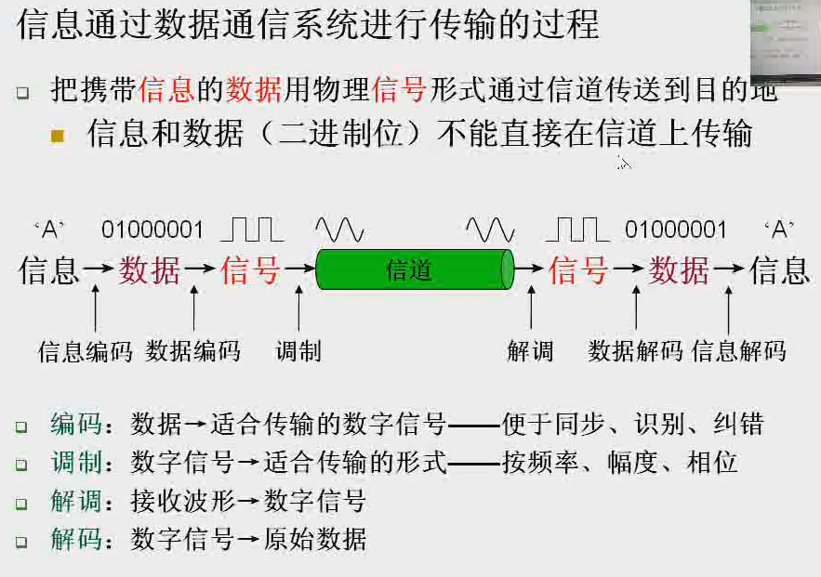
What is meant by data communications ?
composite analog signal
Notes:
信源编码；信道编码

Slide 3
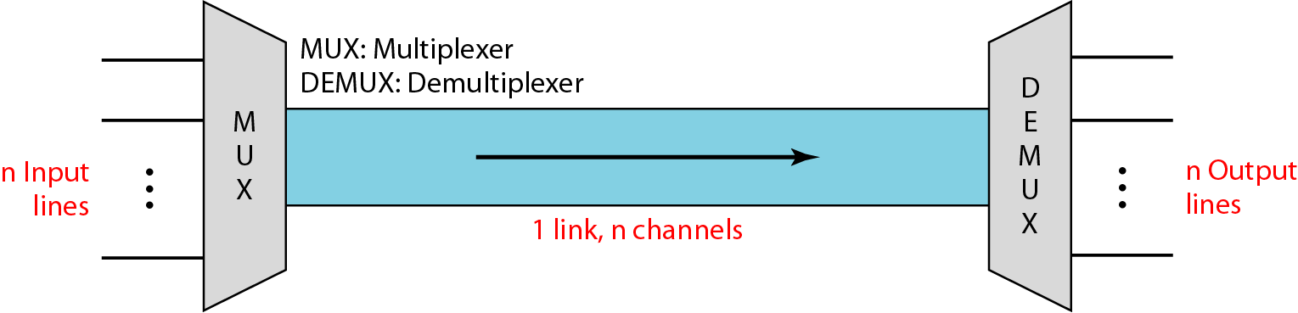
What is meant by channel (信道或通道)?
transmission media such as wire, cable, fiber, air, and an underlying network, and so on, are abstracted as a link.
抽象或理解或称呼为
Link 链路
分时或分频或码分使用
channel
或某一段时间上使用
或某一段频率

Slide 4
Chapter 00 Data and Signals
0.1 Analog and Digital
Analog and Digital Data
Analog and Digital Signal
Periodical and Nonperiodic Signals
0.2 Periodical Analog Signals
Sine Wave, Phase and Wavelength
Time and Frequency Domains
Composite Signals
Bandwidth
0.3 Digital Signals
0.4 Transmission Impairment
Attenuation, Distortion, and Noise
0.5 Data Rate Limits
Noiseless Channel: Nyquist Bit Rate
Noisy Channel: Shannon Capacity
Using Both Limits
0.6 Performance
Bandwidth
Throughput
Latency (Delay)
Bandwidth-Delay Product
Jitter

Slide 5
0.1 Analog and Digital
Data can be analog or digital.
The term analog data refers to information that is continuous; digital data refers to information that has discrete states.
Analog data take on (呈现；具有) continuous values.
Digital data take on discrete values.
Topics discussed in this section:
Analog and Digital Data Analog and Digital Signals Periodic and Nonperiodic Signals

Slide 6
0.1.1 Analog and Digital Data
Analog data are continuous and take on continuous values.
Digital data have discrete states and take on discrete values.
For example, data are stored in computer memory in the form of 0s and 1s.
They can be converted (数据编码) to a digital signal or modulated (调制前还需进行信道或数据编码) into analog signal for transmission across a medium.

Slide 7
0.1.2 Analog and Digital Signal
Like the data they represent, signals can be analog or digital.
An analog signal has infinitely many levels of intensity (强度) over a period of time.
As the wave moves from value A to value B, it passes through and includes an infinite number of values along its path.
An digital signal, on the other hand, can have only a limited number of defined values.
Although each value can be any number, it is often as simple as 1 and 0.

Slide 8
0.1.2 Analog and Digital Signal
The simplest way to show signals is by plotting them on a pair of perpendicular axes.
The vertical axis represents the value or strength of a signal.
The horizontal axis represents time.
Figure 0.1 illustrates an analog signal and a digital signal.
Notes:
axis axes

Slide 9
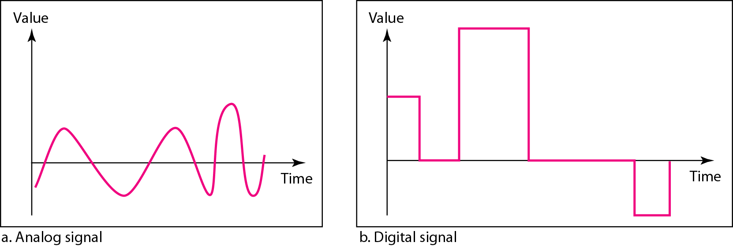
Figure 0.1 Comparison of analog and digital signals

Slide 10
0.1.2 Analog and Digital Signal
The curve representing the analog signal passes through an infinite number of points.
The vertical lines of the digital signal, however, demonstrate the sudden jump that the signal makes from value to value.

Slide 11
0.1.3 Periodic and Nonperiodic Signals
Both analog and digital signals can take one of two forms: periodic or nonperiodic.
A periodic signal completes a pattern within a measurable time frame (时间范围), called a period, and repeats that pattern over subsequent identical periods.
The completion of one full pattern (模式) is called a cycle.

Slide 12
0.1.3 Periodic and Nonperiodic Signals
A nonperiodic signal changes without exhibiting a pattern or cycle that repeats over time.
In data communications, we commonly use
periodic analog signals because they need less bandwidth and
nonperiodic digitals because they can represent variation in data.

Slide 13
Chapter 00 Data and Signals
0.1 Analog and Digital
Analog and Digital Data
Analog and Digital Signal
Periodical and Nonperiodic Signals
0.2 Periodical Analog Signals
Sine Wave, Phase and Wavelength
Time and Frequency Domains
Composite Signals
Bandwidth
0.3 Digital Signals
0.4 Transmission Impairment
Attenuation, Distortion, and Noise
0.5 Data Rate Limits
Noiseless Channel: Nyquist Bit Rate
Noisy Channel: Shannon Capacity
Using Both Limits
0.6 Performance
Bandwidth
Throughput
Latency (Delay)
Bandwidth-Delay Product
Jitter

Slide 14
0.2 Periodic Analog Signals
Periodic analog signals can be classified as simple or composite.
A simple periodic analog signal, a sine wave, cannot be decomposed into simpler signals.
A composite periodic analog signal is composed of multiple sine waves.
Topics discussed in this section:
Sine Wave Wave length Time and Frequency Domain Composite Signals
Bandwidth

Slide 15
0.2.1 Sine Wave
The sine wave is the most fundamental form of a periodic analog signal.
When we visualize [形象化] it as a simple oscillating curve, its change over the course of a cycle is a smooth and consistent, a continuous, rolling (起伏的) flow.
Each cycle consists of a single arc above the time axis followed by a single arc below it.
A sine wave can be represented by three parameters: the peak amplitude, the frequency, and the phase.
Notes:
consistent 始终如一的，一致的；坚持的。
continuous 连续的，持续的；继续的；连绵不断的

Slide 16
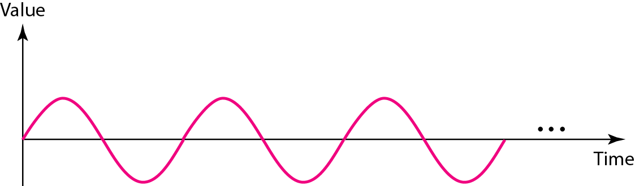
Figure 0.2 A sine wave

Slide 17
1. Peak Amplitude
The peak amplitude of a signal is the absolute value of its highest intensity, proportional to the energy it carries.
For electric signals, peak amplitude is normally measured in volts.
Figure 0.3 shows two signals and their peak amplitudes.

Slide 18
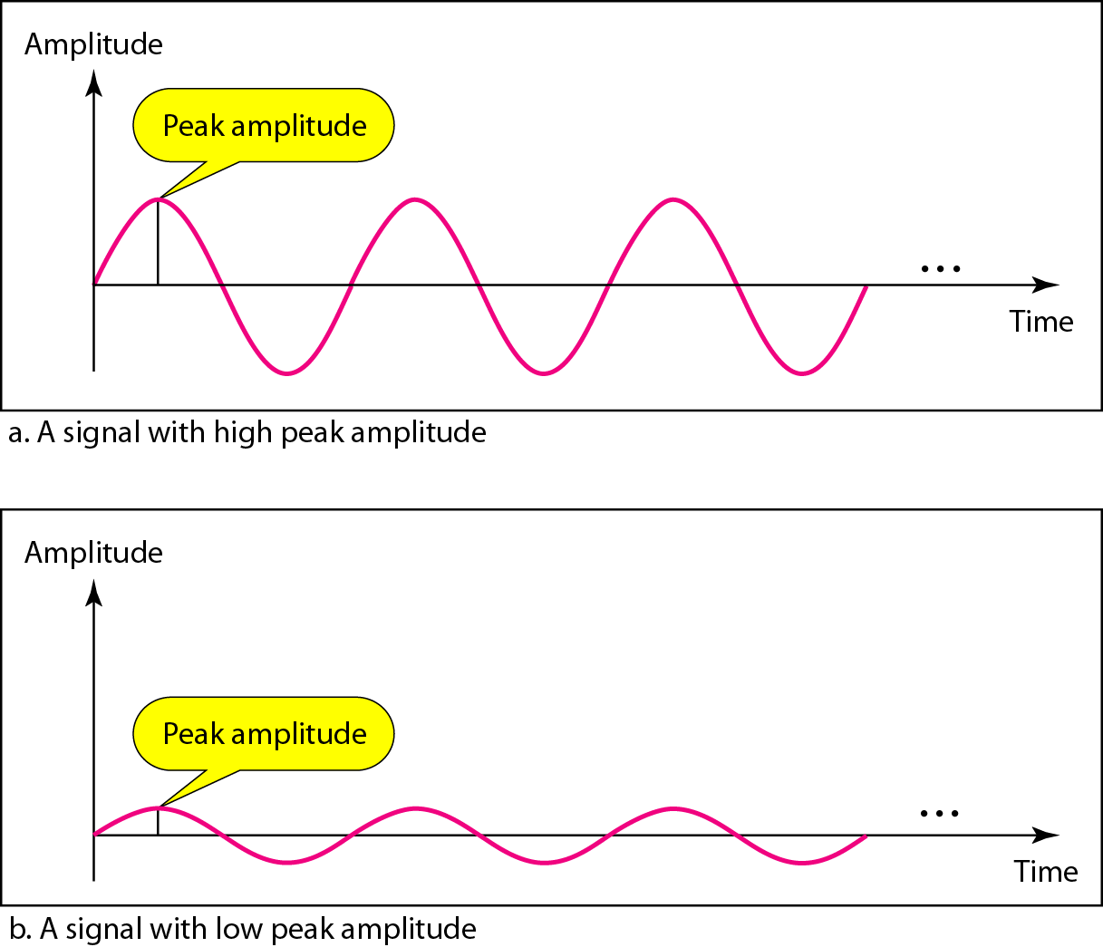
Figure 0.3 Two signals with the same phase and frequency, but different amplitudes

Slide 19
Example 0.1
The power in your house can be represented by a sine wave with a peak amplitude of 155 to 170 V.
However, it is common knowledge that the voltage of the power in U.S. homes is 110 to 120 V.
This discrepancy is due to the fact that these are root mean square (RMS, 均方根) values.
The signal is squared and then the average amplitude is calculated.
The peak value is equal to 2^{½} × RMS value.
Notes:
RMS值实际就是有效值, 就是一组统计数据的平方的平均值的平方根。 RMS ＝(X₁^{平方}＋X₂^{平方}＋......＋X_{n}^{平方})/n 的1/2次方。
在直流DC电路中，电压或电流的定义很简单，但在交流AC电路中，其定义就较为复杂，有多种定义方式。
均方根RMS指的是定义AC波的有效电压或电流的一种最普遍的数学方法。
要得出RMS值需要对表示AC波形的函数执行三个数学操作：
(1)计算波形函数(一般是正弦波)的平方值。
(2)对第一步得到的函数求时间平均值。
(3)求第二步得到的函数的平方根。
在一个阻抗由纯电阻组成的电路中，AC波的RMS值通常称作有效值或DC等价值。
比如，一个100V RMS的AC源连接着一个电阻器，并且其电流产生50W热量，那么对于100V连接着这个电阻器的电源来说也将产生50W的热量。
对正弦波来说，RMS值是峰值的0.707倍，或者是峰-峰值的0.354倍。
家用电压是以RMS来表示的。所谓的“117V”的交流电，其峰值(PK)约为165V，峰-峰值(PK-PK)约为330V。

Slide 20
Example 0.2
The voltage of a battery is a constant; this constant value can be considered a sine wave, as we will see later.
For example, the peak value of an AA battery is normally 1.5 V.
Notes:
AA battery 五号电池

Slide 21

2. Period and Frequency
Period refers to the amount of time, in seconds, a signal needs to complete 1 cycle.
Frequency refers to the number of periods in 1s.
Note that period and frequency are just one characteristic defined in two ways.

Slide 22

Note
Frequency and period are the inverse of each other.

Slide 23
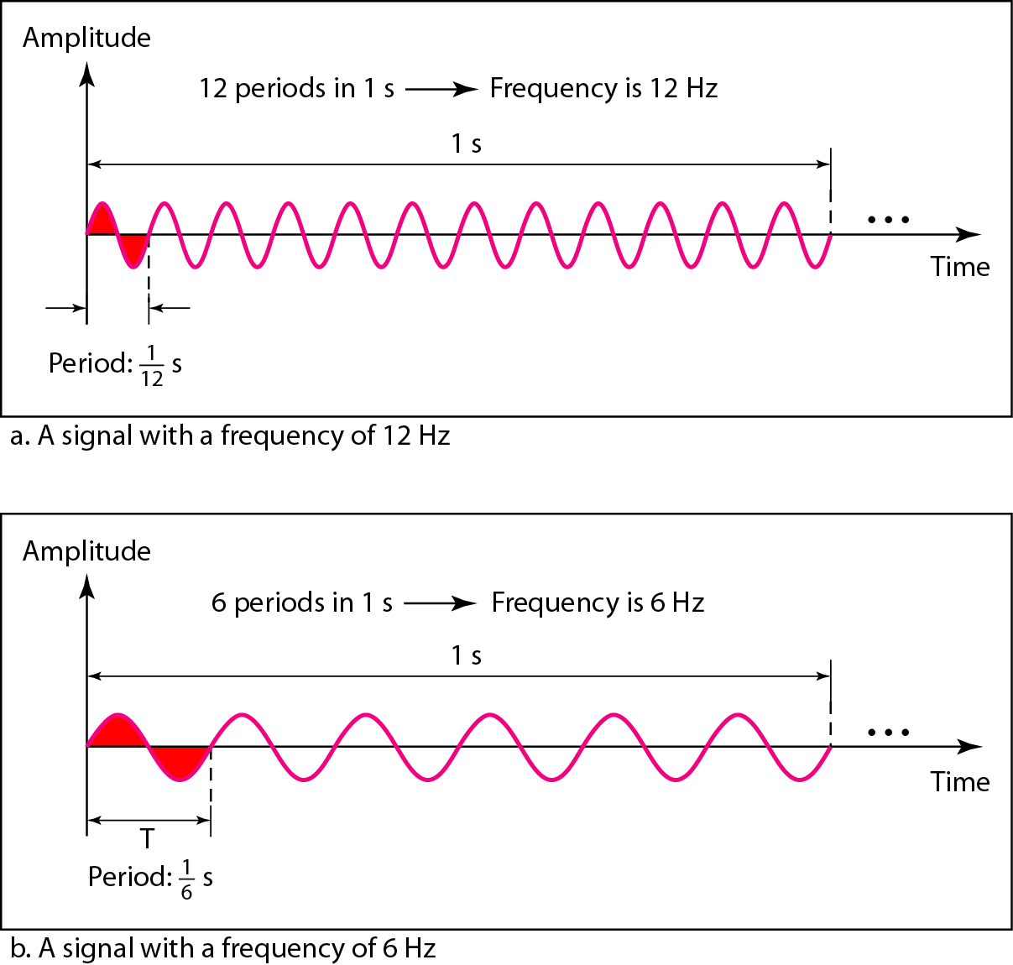
Figure 0.4 Two signals with the same amplitude and phase, but different frequencies

Slide 24
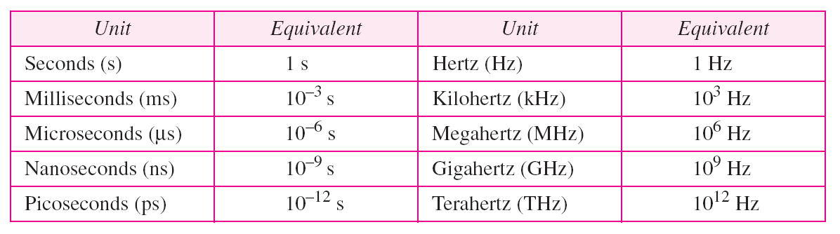
Table 0.1 Units of period and frequency

Slide 25
Example 0.3
The power we use at home has a frequency of 60 Hz.
The period of this sine wave can be determined as follows:
This means that the period of the power for our lights at home is 16.6 ms.
Our eyes are not sensitive enough to distinguish these rapid changes in amplitude.
Notes:
light n. 灯光（light的复数）；（供食用的）家畜的肺脏

Slide 26
Example 0.4
Express [表达] a period of 100 ms in microseconds.
Solution
From Table 0.1 we find the equivalents of 1 ms (1 ms is 10⁻³ s) and 1s ( 1s is 10⁶ μs ).
We make the following substitutions:

Slide 27
Example 0.5
The period of a signal is 100 ms.
What is its frequency in kilohertz?
Solution
First we change 100 ms to seconds, and then we calculate the frequency from the period (1Hz = 10⁻³ kHz).

Slide 28
3. More about Frequency
We already know that frequency is the relationship of a signal to time and that the frequency of a wave is the number of cycles it completes in 1s.
But another way to look at frequency is as a measurement of the rate of change.
Electromagnetic signals are oscillating waveforms; that is, they fluctuate continuously and predictably above and below a mean energy level.

Slide 29
3. More about Frequency
A 40-Hz signal has one-half the frequency of an 80-Hz signal; it completes 1 cycle in twice the time of the 80-Hz signal,
so each cycle also takes twice as long to change from its lowest to its highest voltage levels.
Frequency, therefore, though described in cycles per second, is a general measurement of the rate of change of a signal with respect to time.

Slide 30
3. More about Frequency
If the value of a signal changes over a very short span of time, its frequency is high.
If the value of a signal changes over a very long span of time, its frequency is low.

Slide 31
4. Two Extremes
What if a signal does not change at all?
What if it maintain a constant voltage level [电压电平] for the entire time it is active?
In such a case, its frequency is zero.
Conceptually, this idea is a simple one.
If a signal does not change at all, it never completes a cycle, so its frequency is 0 Hz.

Slide 32
4. Two Extremes
But what if a signal changes instantaneously?
What if it jumps from one level to another in no time?
Then its frequency is infinite.
In other words, when a signal changes instantaneously, its period is zero;
Since frequency is the inverse of the period, in this case, the frequency is 1/0, or infinite (unbounded) .

Slide 33
Note
If a signal does not change at all, its frequency is zero.
If a signal changes instantaneously, its frequency is infinite.

Slide 34
0.2.2 Phase
Phase describes the position of the waveform relative to time 0.
If we think of the wave as something that can be shifted backward or forward along the time axis, phase describes the amount of that shift (偏移).
It indicates the status of the first cycle.
Phase is measured in degrees or radians.

Slide 35
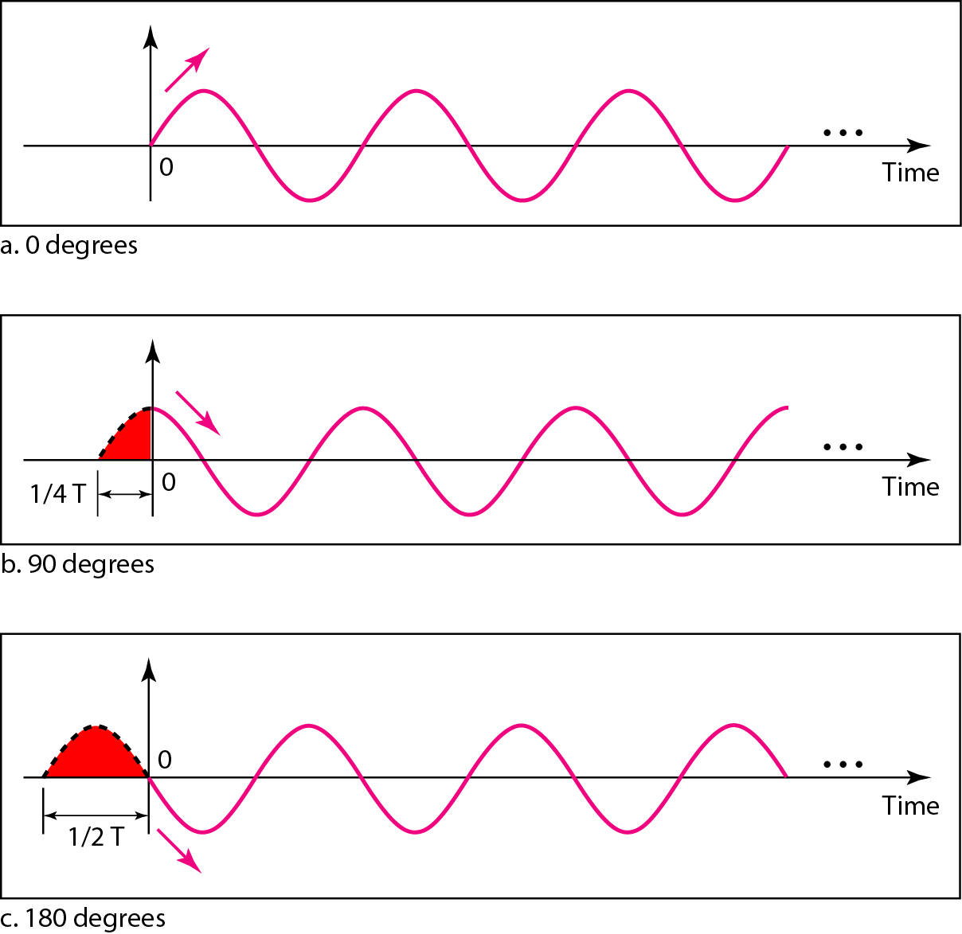
Figure 0.5 Three sine waves with the same amplitude and frequency, but different phases

Slide 36
Example 0.6
A sine wave is offset 1/6 cycle with respect to time 0.
What is its phase in degrees and radians?
Solution
We know that 1 complete cycle is 360. Therefore, 1/6 cycle is

Slide 37
0.2.3 Wavelength
Wavelength is another characteristic of a signal traveling through a transmission medium.
Wavelength binds the period or the frequency of a simple sine wave to the propagation speed of the medium.

Slide 38
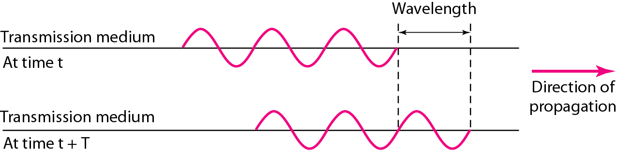
0.2.3 Wavelength
Figure 0.6 wavelength and period

Slide 39
0.2.3 Wavelength
While the frequency of a signal is independent of the medium, the wavelength depends on both the frequency and medium.
In data communications, we often use wavelength to describe the transmission of light in an optical fiber.
Wavelength is a property of any type of signal.
Notes:
optical fiber: fiber optics

Slide 40
0.2.4 Time and Frequency Domains
A sine wave is comprehensively defined by its amplitude, frequency, and phase.
We have been showing a sine wave by using what is called a time-domain plot.
The time-domain plot shows changes in signal amplitude with respect to time (it is an amplitude-versus-time plot).
Phase is not explicitly shown on a time-domain plot.

Slide 41
0.2.4 Time and Frequency Domains
To show the relationship between amplitude and frequency, we can use what is called a frequency-domain plot.
A frequency-domain plot is concerned with only the peak value and the frequency.
Changes of amplitude during one period are not shown.

Slide 42
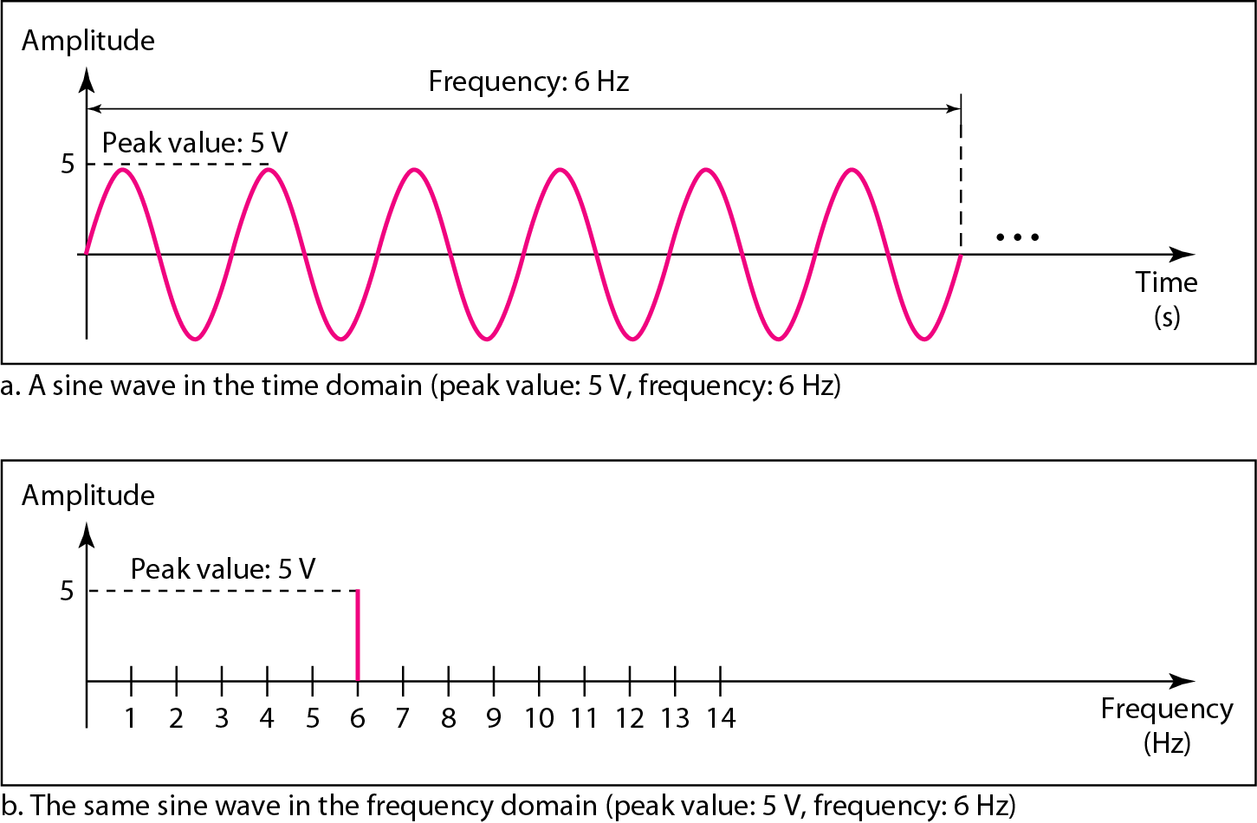
Figure 3.7 The time-domain and frequency-domain plots of a sine wave

Slide 43
Note
A complete sine wave in the time domain can be represented by one single spike in the frequency domain.

Slide 44
Example 0.7
The frequency domain is more compact and useful when we are dealing with more than one sine wave.
For example, Figure 0.8 shows three sine waves, each with different amplitude and frequency.
All can be represented by three spikes in the frequency domain.

Slide 45
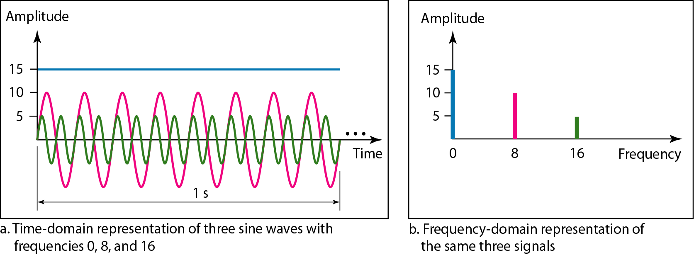
Figure 0.8 The time domain and frequency domain of three sine waves
Notes:
cigarette
spaghetti

Slide 46
0.2.5 Composite Signals
A single-frequency sine wave is not useful in data communications.
We need to send a composite signal, a signal made of many simple sine waves.
In the early 1900s, the French mathematician Jean- Baptiste Fourier showed that any composite signal is actually a combination of simple sine waves with different frequencies, amplitudes, and phases.
Notes:
Jean-Baptiste 巴普蒂斯特

Slide 47
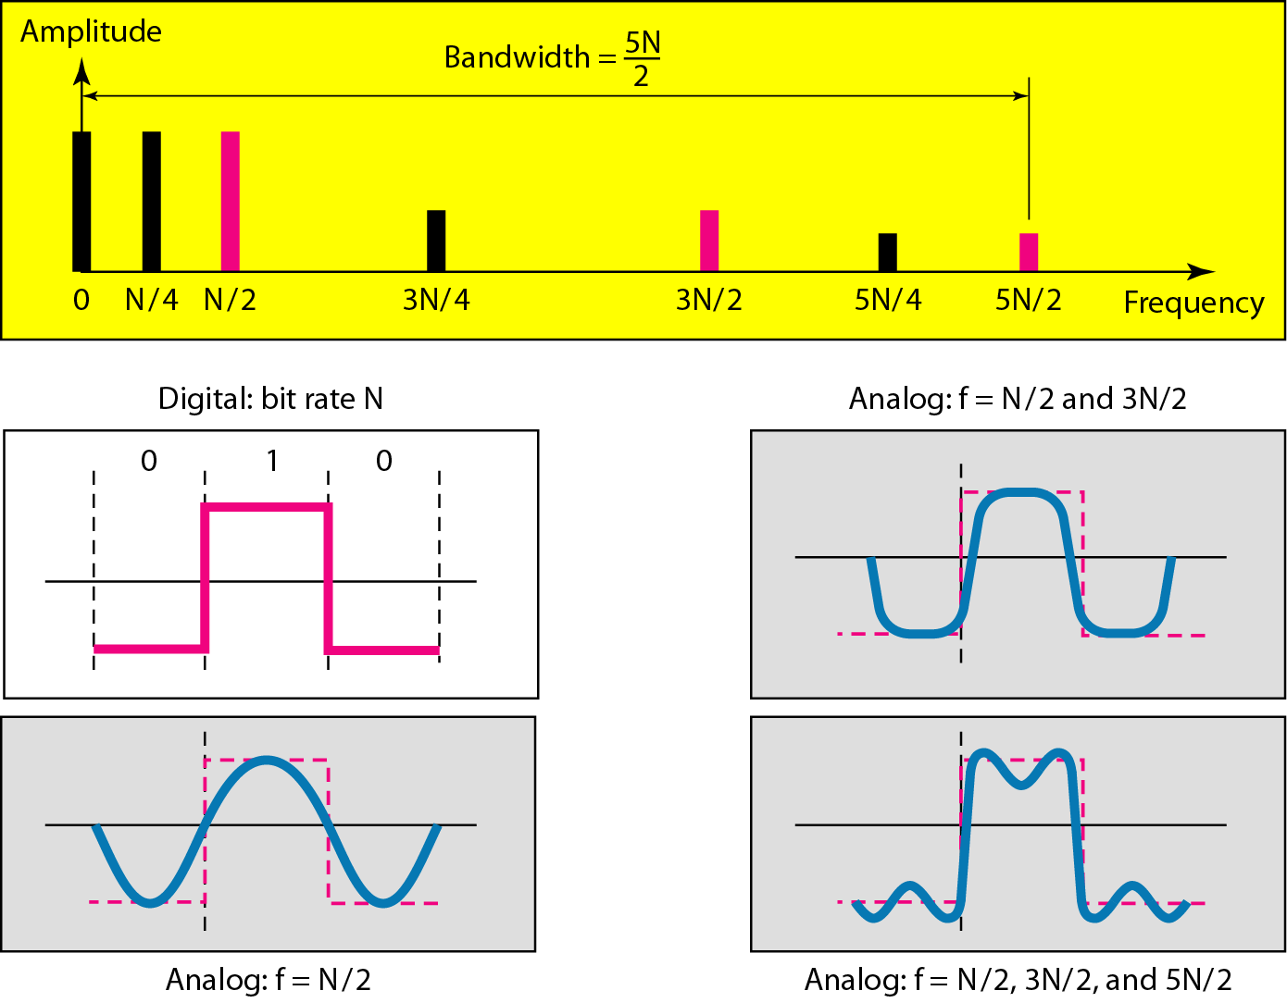
Simulating a digital signal with 1 to 3 sine waves

Slide 48
0.2.5 Composite Signals
where f = 1/T is the fundamental frequency, a_{n} and b_{n} are the sine and cosine amplitudes of the nth harmonics (terms), and c is a constant.
Such a decomposition is called a Fourier series [傅里叶级数].

Slide 49
0.2.5 Composite Signals
From the Fourier series, the function can be reconstructed;
that is, if the period, T, is known and the amplitudes are given, the original function (原函数) of time can be found by performing the sums of the equation above.
Notes:
The results of performing these operations are as follows:

Slide 50
0.2.5 Composite Signals
A data signal that has a finite duration, which all of them do (所有的数据信号都是这样的), can be handled by just imagining that
it repeats the entire pattern over and over forever
i.e., the interval from T to 2T is the same as from 0 to T, etc.
Notes:
which : a finite duration
all of them : (他们全部；他们大家), 从而指的是所有的数据信号.

Slide 51
Fourier series deduction

Slide 52
Fourier series deduction

Slide 53
Fourier series deduction

Slide 54
0.2.5 Composite Signals
To see what all this has to do with data communications, let us consider a specific example:
the transmission of the ASCII character ''b'' encoded in an 8-bit byte.
The bit pattern that is to be transmitted is 01100010.
The left-hand part of the following figure (a) shows the voltage output by the transmitting computer.
Notes:
American Standard Code for Information Interchange

Slide 55
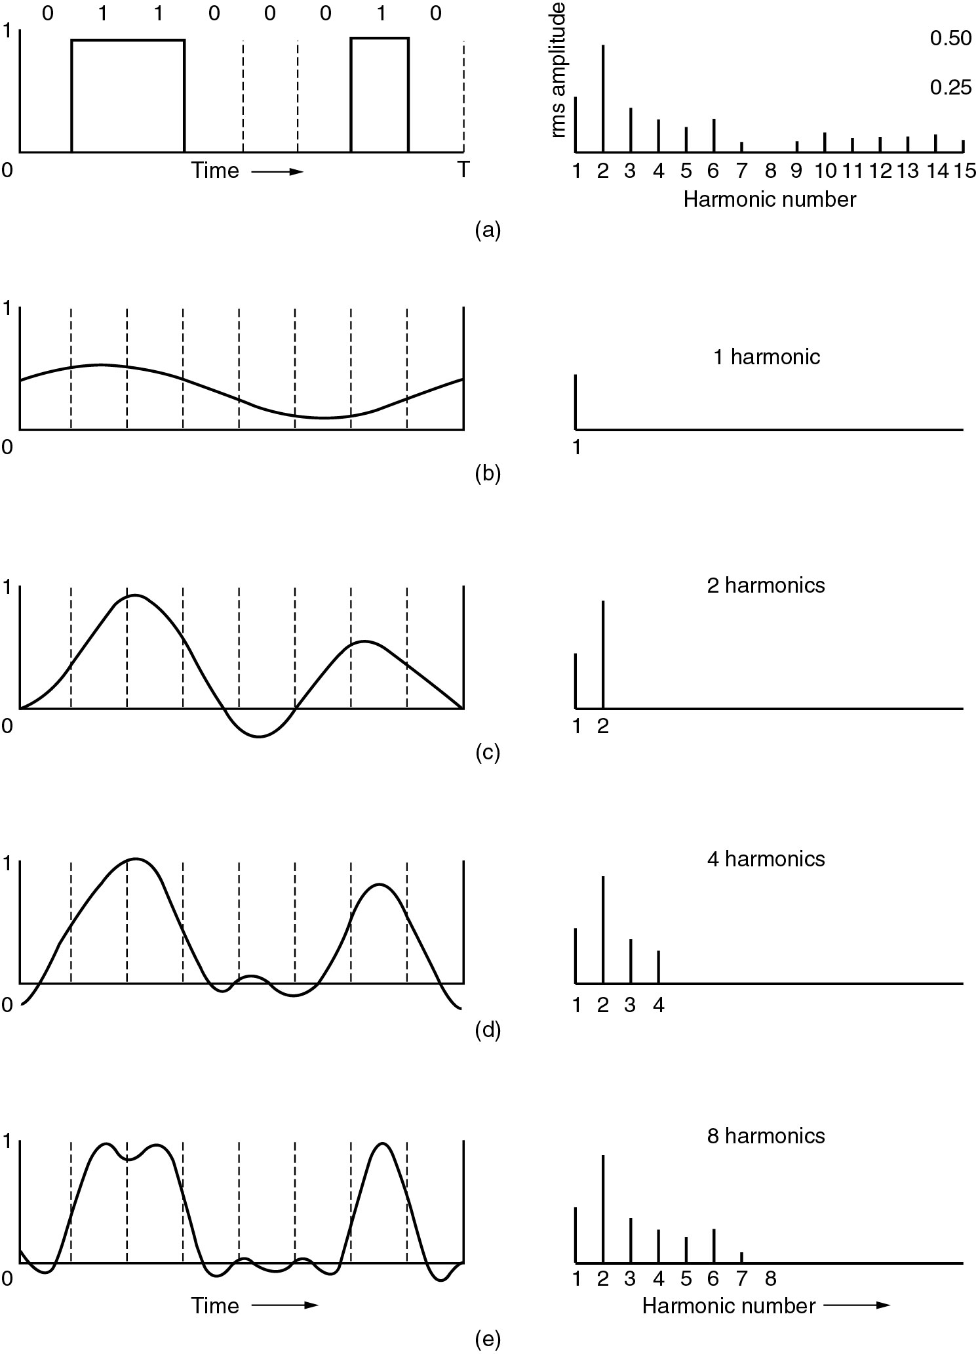
0.2.5 Composite Signals
(a) A binary signal and its root-mean-square Fourier amplitudes.
(b) – (c) Successive approximations to the original signal (原始信号).

Slide 56
0.2.5 Composite Signals
(d) – (e) Successive approximations to the original signal.

Slide 57
0.2.5 Composite Signals
The root-mean-square amplitudes, , for the first few terms are shown on the right-hand side of the Figure.
These values are of interest because their squares (平方) are proportional to the energy transmitted at the corresponding frequency.

Slide 58
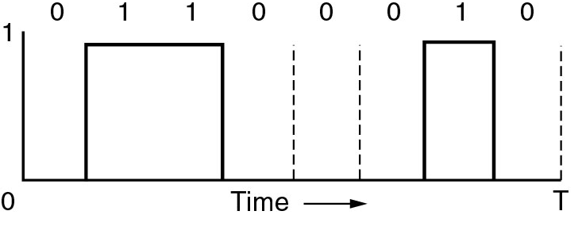
Examples
Notes:
换元要换限

Slide 59
Examples

Slide 60
Examples

Slide 61
Examples
The Fourier analysis of this signal yields the coefficients:

Slide 63
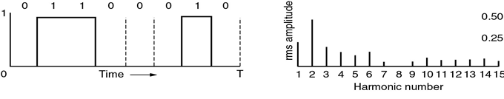
Examples

Slide 64
0.2.5 Composite Signals
No transmission facility can transmit signals without losing some power in the process.
If all the Fourier components were equally diminished, the resulting signal would be reduced in amplitude but not distorted [i.e., it would have the same nice squared-off [方格的] shape as Fig. (a)].
Unfortunately, all transmission facilities diminish (减少) different Fourier components by different amounts, thus introducing distortion [失真].
Notes:
would 将，将会（will 的过去式）；会，就；想；请；愿意；也许；老是；要是；表原来的目的

Slide 65
0.2.5 Composite Signals
Usually, for a wire, the amplitudes are transmitted mostly [多半地] undiminished from 0 up to some frequency f_{c} [measured in cycles/sec or Hertz (Hz)], with all frequencies above this cutoff frequency (截止频率) attenuated.
The width of the frequency range transmitted without being strongly attenuated is called the bandwidth.
In practice, the cutoff is not really sharp (明显), so often the quoted bandwidth is from 0 to the frequency at which the received power has fallen by half. ｛所以，通常所说的带宽是指从 0 到某一个能保留一半能量的频率处。｝
Notes:
所以，通常引用的带宽是指从0到某一个能保留一半能量的频率处。

Slide 66
0.2.5 Composite Signals
A composite signal can be periodic or nonperiodic.
If the composite signal is periodic, the decomposition gives a series of simple sine waves with discrete frequencies
— frequencies that have integer values (1, 2, 3, and so on);
If the composite signal is nonperiodic, the decomposition gives a combination of sine waves with continuous frequencies
— frequencies that have real values.

Slide 67
Example 0.8
Figure 0.9 shows a periodic composite signal with frequency f.
This type of signal is not typical of those found in data communications.

Slide 68
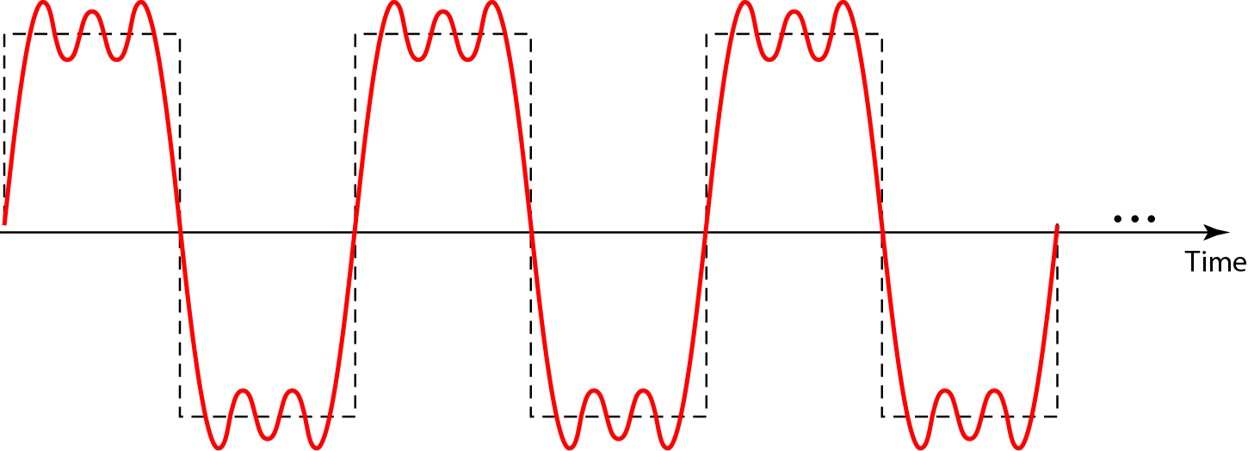
Figure 0.9 A composite periodic signal

Slide 69
Example 0.8
We can consider it to be three alarm systems [报警系统], each with a different frequency.
The analysis of this signal can give us a good understanding of how to decompose (分解) signals.
It is very difficult to manually decompose this signal into a series of simple sine waves (正弦波).
However, there are tools, both hardware and software, that can help us do the job.

Slide 70
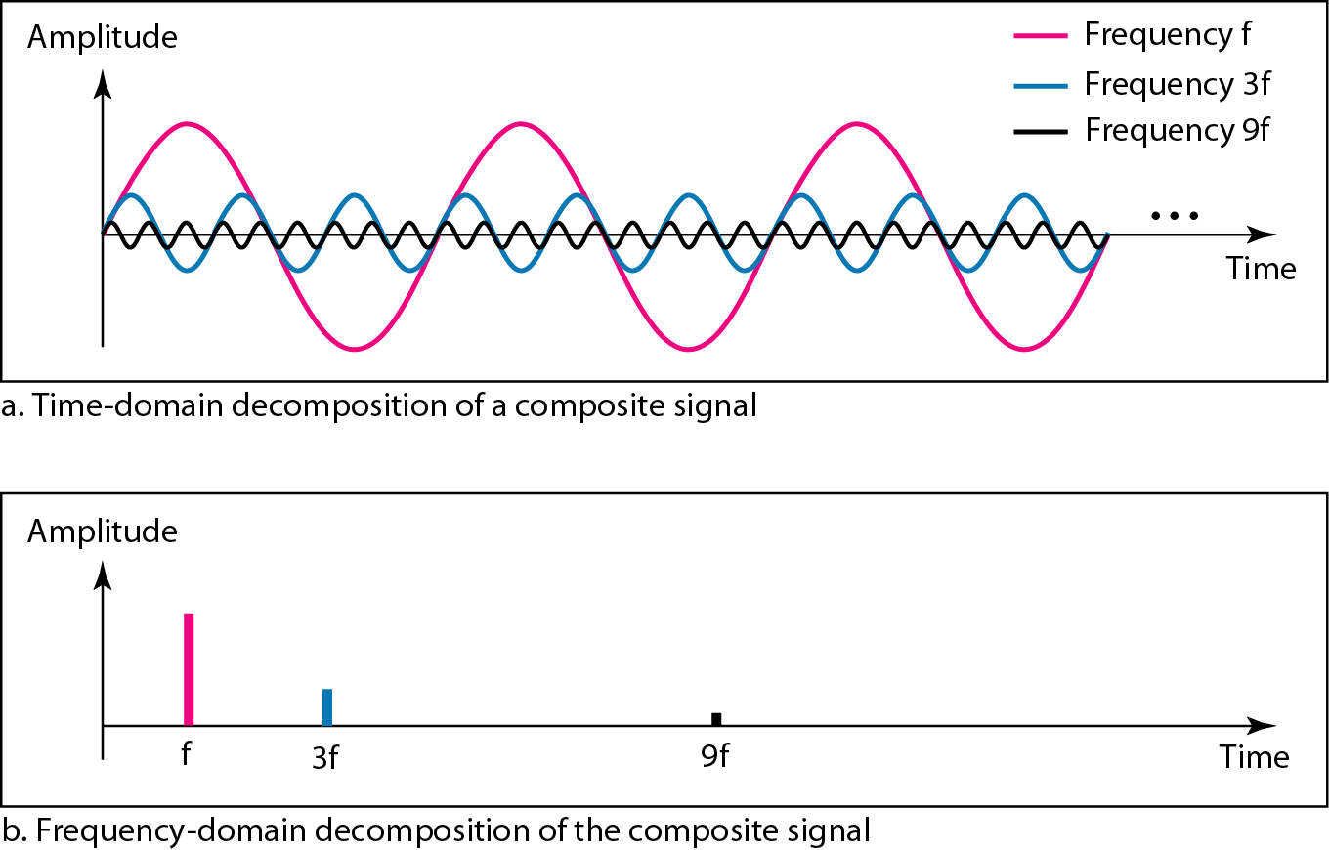
Figure 0.10 Decomposition of a composite periodic signal in the time and frequency domains

Slide 71
Example 0.9
Figure 0.11 shows a nonperiodic composite signal.
It can be the signal created by a microphone or a telephone set when a word or two (简单的交谈或发言) is pronounced.

Slide 72
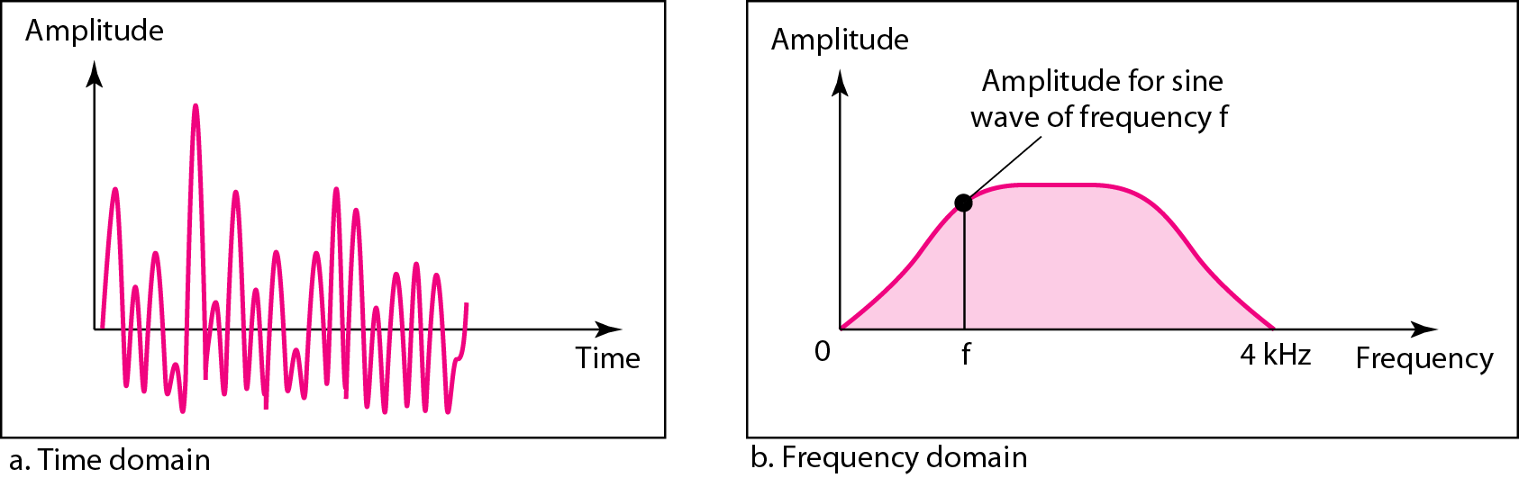
Figure 0.11 The time and frequency domains of a nonperiodic signal

Slide 73
Example 0.9
In this case, the composite signal cannot be periodic, because that implies that we are repeating the same word or words with exactly the same tone.
In a time-domain representation of this composite signal, there are an infinite number of simple sine frequencies.
Although the number of frequencies in a human voice is infinite, the range is limited.
A normal human being can create a continuous range of frequencies between 0 and 4 kHz.

Slide 74
0.2.6 Bandwidth
The range of frequencies contained in a composite signal is its bandwidth.
The bandwidth is normally a difference between two numbers.
The bandwidth of a composite signal is the difference between the highest and the lowest frequencies contained in that signal.

Slide 75
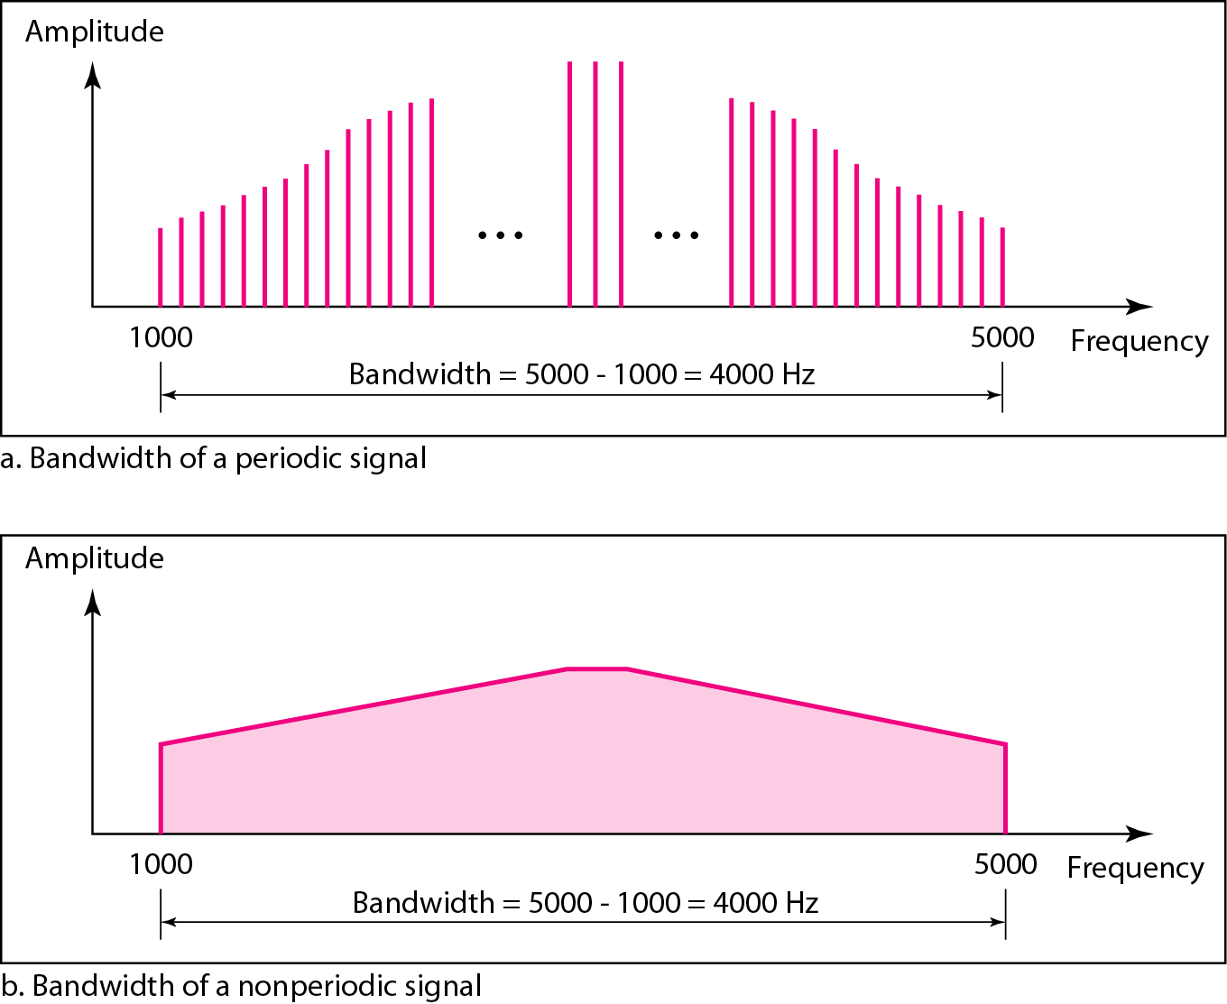
Figure 0.12 The bandwidth of periodic and nonperiodic composite signals

Slide 76
0.2.6 Bandwidth
[Andrew] The bandwidth is a physical property of the transmission medium and usually depends on the construction, thickness, and length of a wire or fiber.
Filters (滤波器) are often used to further limit the amount of bandwidth available to each customer.
For example, a telephone wire may have a bandwidth of 1 MHz for short distances, but telephone companies add a filter restricting each customer to about 3100 Hz.
Notes:
The bandwidth is a physical property of the transmission medium that depends on, for example, the construction, thickness, and length of a wire or fiber.
Filters are often used to further limit the bandwidth of a signal.
802.11 wireless channels are allowed to use up to roughly 20 MHz, for example, so 802.11 radios filter the signal bandwidth to this size.
As another example, traditional (analog) television channels occupy 6 MHz each, on a wire or over the air.
This filtering lets more signals share a given region of spectrum, which improves the overall efficiency of the system.
It means that the frequency range for some signals will not start at zero, but this does not matter.
The bandwidth is still the width of the band of frequencies that are passed, and the information that can be carried depends only on this width and not on the starting and ending frequencies.
Signals that run from 0 up to a maximum frequency are called baseband signals.
Signals that are shifted to occupy a higher range of frequencies, as is the case for all wireless transmissions, are called passband (通频带) signals.

Slide 77
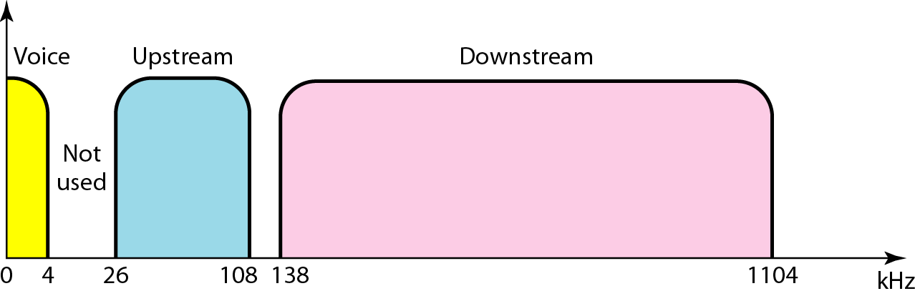
Bandwidth division in a telephone wire
Filters (过滤器) are often used to further limit the amount of bandwidth available to each customer.

Slide 78
0.2.6 Bandwidth
This bandwidth is adequate for intelligible speech and improves system-wide efficiency by limiting resource usage by customers.

Slide 79
0.2.5 Composite Signals
(a) A binary signal and its root-mean-square Fourier amplitudes.
(b) – (c) Successive approximations to the original signal (原始信号) .

Slide 80
Bandwidth
Given a bit rate of b bits/sec, the time required to send 8 bits (for example) 1 bit at a time is 8/b sec (周期的大小), so the frequency of the first harmonic is b/8 Hz.
An ordinary telephone line, often called a voice-grade line, has an artificially-introduced cutoff frequency just above 3000 Hz.
This restriction means that the number of the highest harmonic passed through (最高的可以通过的谐波次数) is roughly 3000/(b÷8) or 24,000/b (the cutoff is not sharp, 该截止不是明显的).

Slide 81
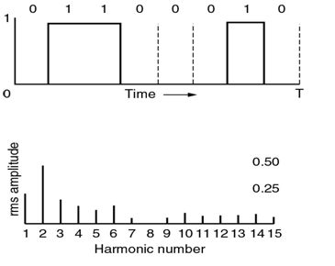
Bandwidth
其计算过程如下：
Given a bit rate of b bits/sec
the time required to send 8 bits 1 bit at a time is 8/b sec, e.g. T = 8/b
一次谐波F₁ = 1/T = b/8
二次谐波F₂ = 2F₁= 2/T
同理，n次谐波F_{n}= n/T = n*b/8
令F_{n} = 3000 (截止频率)
则n*f = n/T = 3000，n表示该信号所对应的可以通过的最高频率谐波的次数 (发送谐波的最大个数^{cz})。
所以，n = 3,000T = 3,000*8/b = 24,000/b

Slide 82
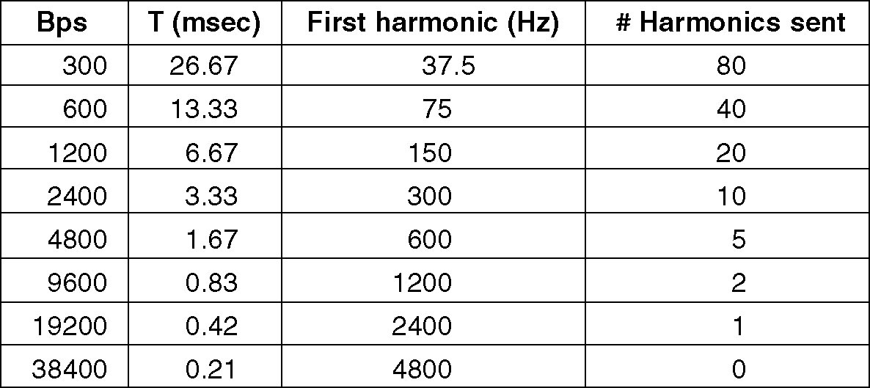
Bandwidth
n = 3,000T = 24,000/b
4.8 kbps
9.6 kbps
19.2 kbps
38.4 kbps
Figure relation between data rate and harmonics
Notes:
以该表的第一行计算为例：
b = 300 bps
T = 8/b = 8/300(s) = 26.67ms(一次谐波，即基波频率。高次谐波是基波的倍数关系)
f = 1/T = b/8 = 37.5(Hz)
n = 24000/b = 80

Slide 83
0.2.6 Bandwidth
It should be obvious that at data rates much higher than 38.4 kbps, there is no hope at all for binary signals, even if the transmission facility is completely noiseless.
In other words, limiting the bandwidth limits the data rate, even for perfect channels.
Notes:
以该表的第一行计算为例：
B = 300
T = 8/b = 8/300(s) = 26.67ms(一次谐波，即基波频率。高次谐波是基波的倍数关系)
F = 1/T = b/8 = 37.5(Hz)
N = 24000/b = 80

Slide 84
Example 0.10
If a periodic signal is decomposed into five sine waves with frequencies of 100, 300, 500, 700, and 900 Hz, what is its bandwidth?
Draw the spectrum, assuming all components have a maximum amplitude of 10 V.
Solution
Let f_{h} be the highest frequency, f_{l} the lowest frequency, and B the bandwidth. Then
The spectrum has only five spikes, at 100, 300, 500, 700, and 900 Hz (see Figure 0.13).

Slide 85
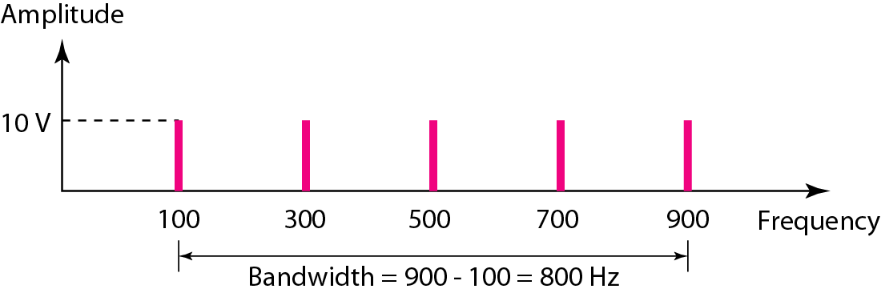
Figure 0.13 The bandwidth for Example 0.10

Slide 86
Example 0.11
A periodic signal has a bandwidth of 20 Hz. The highest frequency is 60 Hz. What is the lowest frequency? Draw the spectrum if the signal contains all integer frequencies of the same amplitude.
Solution
Let f_{h} be the highest frequency, f_{l} the lowest frequency, and B the bandwidth. Then
The spectrum contains all integer frequencies. We show this by a series of spikes (see Figure 0.14).

Slide 87
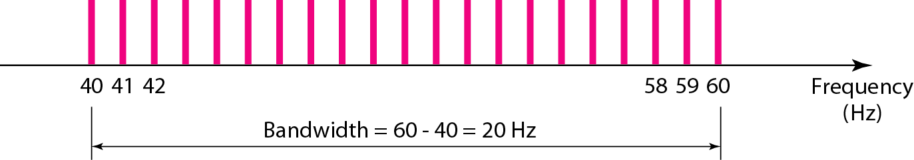
Figure 0.14 The bandwidth for Example 0.11

Slide 88
Example 0.12
A nonperiodic composite signal has a bandwidth of 200 kHz, with a middle frequency of 140 kHz and peak amplitude of 20 V.
The two extreme frequencies have an amplitude of 0. Draw the frequency domain of the signal.
Solution
The lowest frequency must be at 40 kHz and the highest at 240 kHz.
Figure 0.15 shows the frequency domain and the bandwidth.

Slide 89
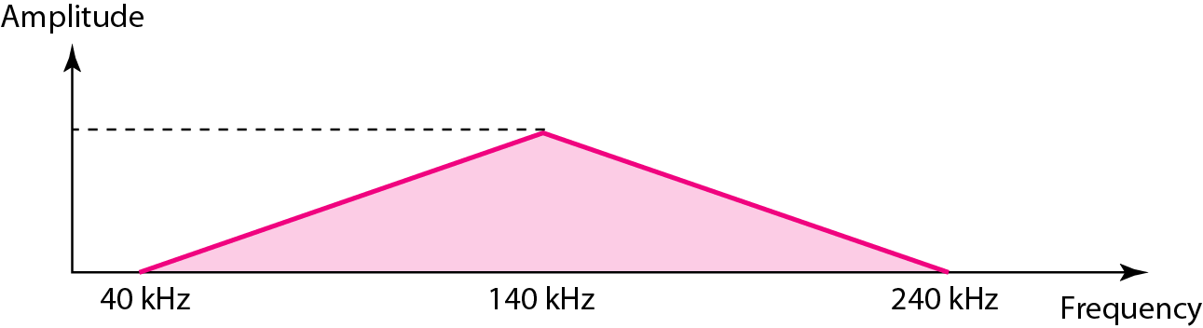
Figure 0.15 The bandwidth for Example 0.12

Slide 90
Example 0.13
An example of a nonperiodic composite signal is the signal propagated by an AM (Amplitude Modulation) radio station.
In the United States, each AM radio station is assigned a 10-kHz bandwidth.
The total bandwidth dedicated to AM radio ranges from 530 to 1700 kHz.
We will show the rationale behind this 10-kHz bandwidth in Chapter C00.

Slide 91
Example 0.14
Another example of a nonperiodic composite signal is the signal propagated by an FM radio station.
In the United States, each FM radio station is assigned a 200-kHz bandwidth.
The total bandwidth dedicated to FM radio ranges from 88 to 108 MHz .
We will show the rationale behind this 200-kHz bandwidth in Chapter C00.

Slide 92
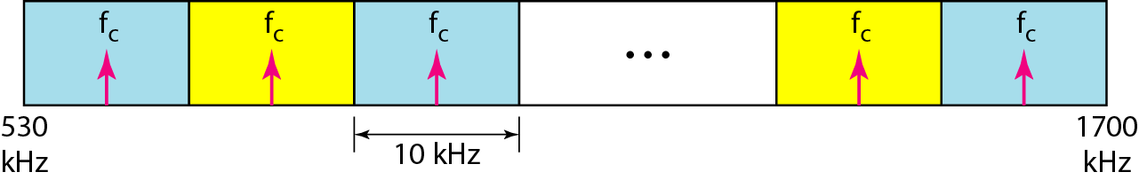
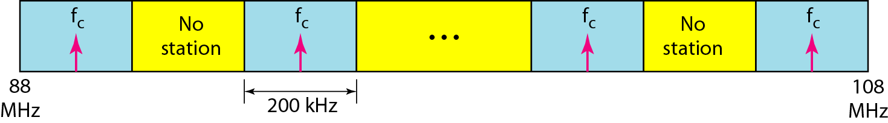
AM and FM Band allocation
Figure AM band allocation
Figure FM band allocation

Slide 93
Example 0.15
Another example of a nonperiodic composite signal is the signal received by an old-fashioned analog black-and-white TV.
A TV screen is made up of pixels (picture elements, 像素) with each pixel being either white or black.
The screen is scanned 30 times per second.
(Scanning is actually 60 times per second, but odd lines are scanned in one round and even lines in the next and then interleaved [隔行扫描的].)

Slide 94
Example 0.15
If we assume a resolution of 525×700 (525 vertical lines and 700 horizontal lines), which is a ratio of 3:4, we have 367,500 pixels per screen.
If we scan the screen 30 times per second, this is 367,500×30 = 11,025,000 pixels per second.
The worst-case scenario is alternating black and white pixels.
In this case, we need to represent one color by the minimum amplitude and the other color by the maximum amplitude.

Slide 95
Example 0.15
We can send 2 pixels per cycle .
Therefore, we need 11,025,000÷2 = 5,512,500 cycles per second, or Hz.
The bandwidth needed is 5.5125 MHz.
The worst-case scenario has such a low probability of occurrence that the assumption is that we need only 70 percent of this bandwidth, which is 3.85 MHz.

Slide 96
Example 0.15
Since audio and synchronization signals are also needed, a 4-MHz bandwidth has been set aside for each black and white TV channel.
An analog color TV channel has a 6-MHz bandwidth.

Slide 97
Chapter 00 Data and Signals
0.1 Analog and Digital
Analog and Digital Data
Analog and Digital Signal
Periodical and Nonperiodic Signals
0.2 Periodical Analog Signals
Sine Wave, Phase and Wavelength
Time and Frequency Domains
Composite Signals
Bandwidth
0.3 Digital Signals
0.4 Transmission Impairment
Attenuation, Distortion, and Noise
0.5 Data Rate Limits
Noiseless Channel: Nyquist Bit Rate
Noisy Channel: Shannon Capacity
Using Both Limits
0.6 Performance
Bandwidth
Throughput
Latency (Delay)
Bandwidth-Delay Product
Jitter

Slide 98
0.3 Digital Signals
In addition to being represented by an analog signal, data or information can also be represented by a digital signal.
For example, a 1 can be encoded as a positive voltage and a 0 as zero voltage.
A digital signal can have more than two levels.
In this case, we can send more than 1 bit for each level.
Topics discussed in this section:
Bit Rate Bit Length Digital Signal as a Composite Analog Signal
Transmission of Digital Signal

Slide 99
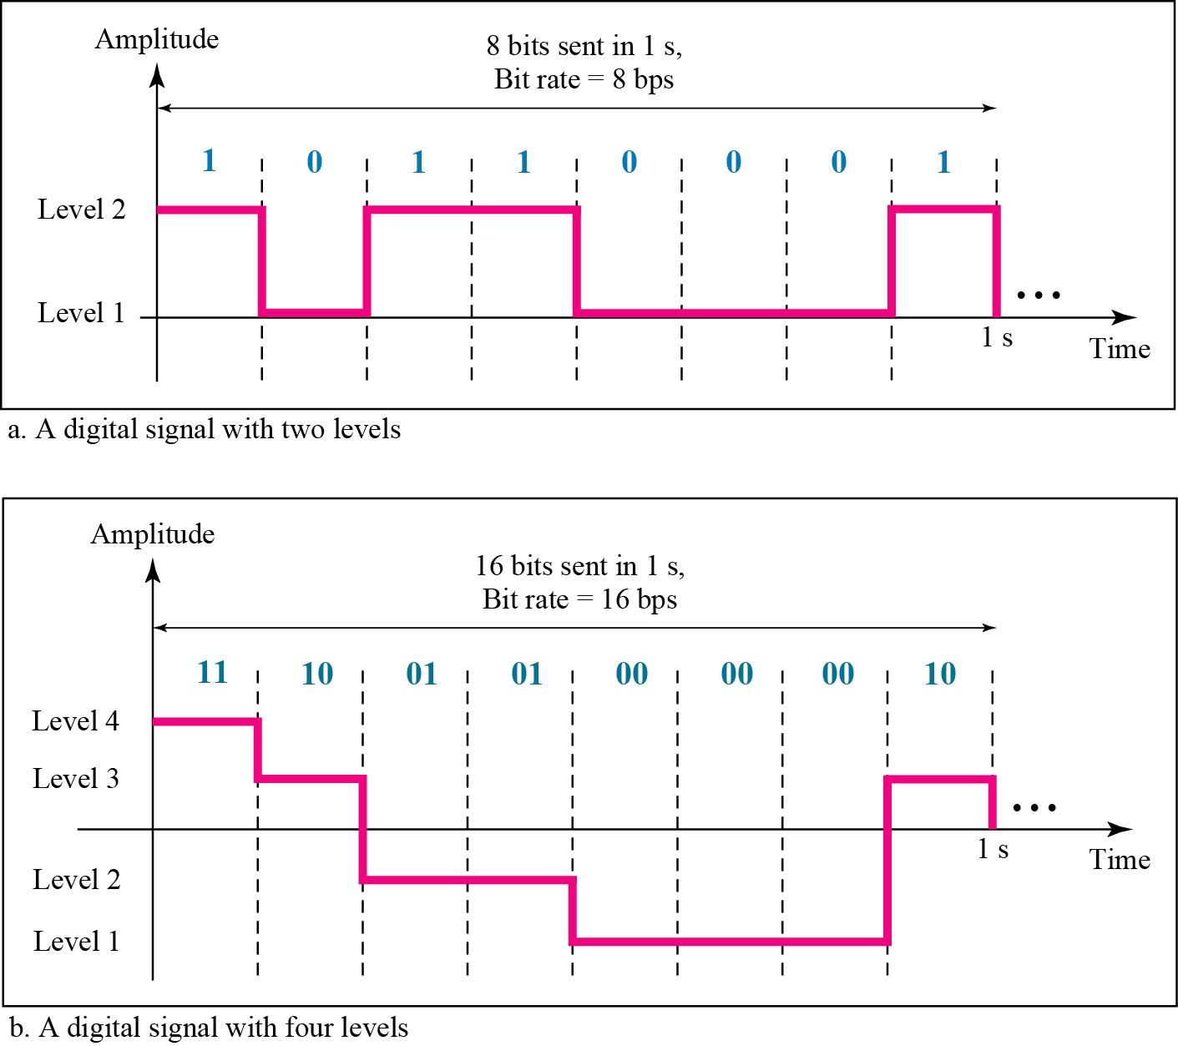
Figure 0.16 Two digital signals: one with two signal levels and the other with four signal levels

Slide 100
0.3 Digital Signals
We send 1 bit per level in part a of the figure and 2 bits per level in part b of the figure.
In general, if a signal has L level, each level needs log₂L bits.
Appendix C reviews information (知识) about exponential and logarithmic functions.

Slide 101
Example 0.16
A digital signal has eight levels.
How many bits are needed per level?
We calculate the number of bits from the formula.
Each signal level is represented by 3 bits. [严格来说，是signal level表示数据的]

Slide 102
Example 0.17
A digital signal has nine levels. How many bits are needed [represented] per level?
We calculate the number of bits by using the formula. Each signal level is represented by 3.17 bits.
However, this answer is not realistic.
The number of bits sent per level needs to be an integer as well as a power of 2.
For this example, 4 bits can represent one level.

Slide 103
0.3.1 Bit Rate
Most digital signals are nonperiodic, and thus period and frequency are not appropriate characteristics.
Another term — bit rate (instead of frequency) — is used to describe digital signals.
The bit rate is the number of bits sent in 1s, expressed bits per second (bps).

Slide 104
Example 0.18
Assume we need to download text documents at the rate of 100 pages per second.
What is the required bit rate of the channel?
Solution
A page is an average of 24 lines with 80 characters in each line.
If we assume that one character requires 8 bits, the bit rate is

Slide 105
Example 0.19
A digitized voice channel, as we will see in Chapter B00, is made by digitizing a 4-kHz bandwidth analog voice signal.
We need to sample the signal at twice the highest frequency (two samples per hertz).
We assume that each sample requires 8 bits. What is the required bit rate?
Solution
The bit rate can be calculated as

Slide 106
Example 0.20
What is the bit rate for high-definition TV (HDTV)?
Solution
HDTV uses digital signals to broadcast high quality video signals.
The HDTV screen is normally a ratio of 16:9.
There are 1920 by 1080 pixels per screen, and the screen is renewed 30 times per second.
Twenty-four bits represents one color pixel.
The TV stations reduce this rate to 20 to 40 Mbps through compression.

Slide 107
0.3.2 Bit Length
We discussed the concept of the wavelength for an analog signal: the distance that one cycle occupies on the transmission medium.
We can define something similar for a digital signal: the bit length.
The bit length is the distance that one bit occupies on the transmission medium.
Bit length = propagation speed × bit duration

Slide 108
数字信号流随时间的变化
在时间轴上信号的宽度随带宽的增大而变窄。
1 μs
NRZ-L
带宽为
1 Mb/s
1 0 1 0 1 1
时间
每秒 10⁶ 个比特
0.25 μs
带宽为
4 Mb/s
时间
每秒 4 × 10⁶ 个比特
Notes:
108
NRZ-L

Slide 109
0.3.3 Digital Signal as a Composite Analog Signal
Based on Fourier analysis, a digital signal is a composite analog signal.
The bandwidth is infinite, as you may have guessed.
We can intuitively come up with the concept when we consider a digital signal.
A digital signal, in the time domain, comprises connected vertical and horizontal line segments.

Slide 110
0.3.3 Digital Signal as a Composite Analog Signal
A vertical line in the time domain means a frequency of infinity (sudden change in time);
a horizontal line in the domain means a frequency of zero (no change in time).
Going from a frequency of zero to a frequency of infinity (and vice versa) implies all frequencies in between are part of the domain.

Slide 111
0.3.3 Digital Signal as a Composite Analog Signal
Fourier analysis can be used to decompose a digital signal.
If the digital signal is periodic, which is rare in data communications, the decomposed digital has a frequency-domain representation with an infinite bandwidth and discrete frequencies.
If the digital signal is nonperiodic, the decomposed signal still has infinite bandwidth, but the frequencies are continuous.

Slide 112
0.3.3 Digital Signal as a Composite Analog Signal
Figure 0.17 shows a periodic and a nonperiodic digital signals and their bandwidths.
Note that both bandwidths are infinite, but the periodic signal has discrete frequencies while the nonperiodic signal has continuous frequencies.

Slide 113
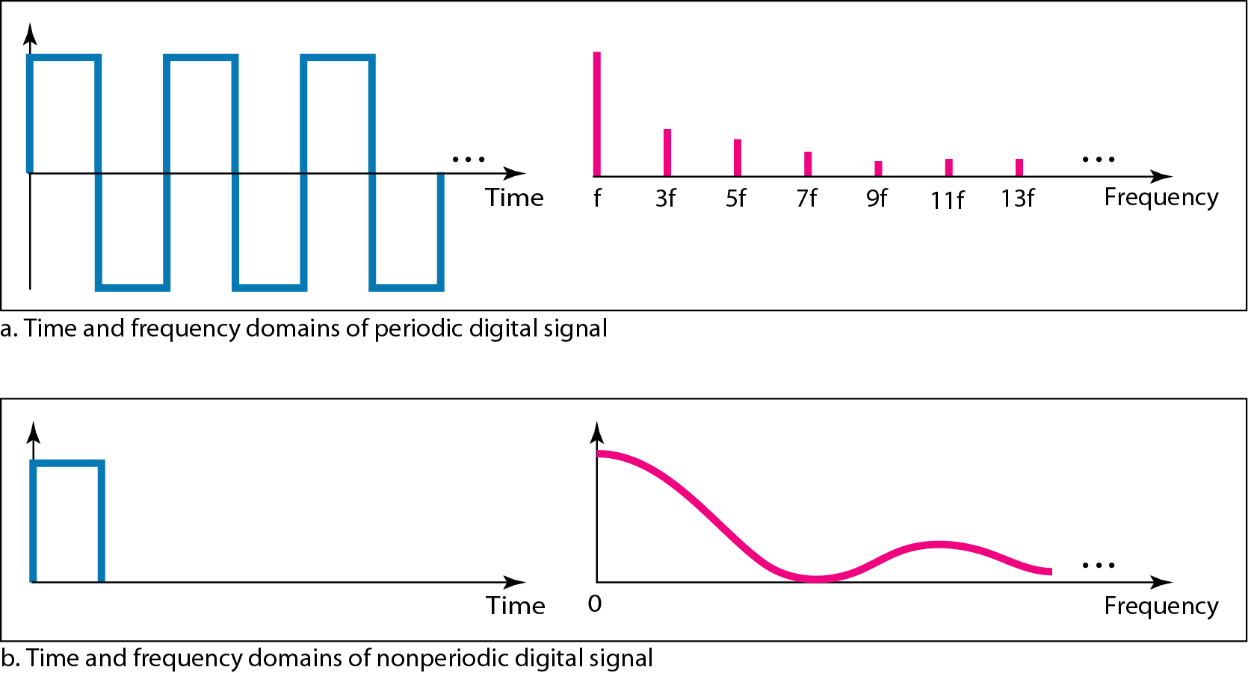
Figure 0.17 The time and frequency domains of periodic and nonperiodic digital signals

Slide 114
0.3.4 Transmission of Digital Signal
The previous discussion asserts that a digital signal, periodic or nonperiodic, is a composite analog signal
with frequencies between zero and infinity.
For the remainder of the discussion, let us consider the case of a nonperiodic digital signal, similar to the ones we encounter in data communications.
The fundamental question is, how can we send a digital signal from point A to point B ?

Slide 115
0.3.4 Transmission of Digital Signal
We can transmit a digital signal by using one of two different approaches:
(1) baseband transmission or
(2) broadband transmission (using modulation)

Slide 116
1. Baseband Transmission
Baseband transmission means sending a digital over a channel without changing the digital signal to an analog signal.
A digital signal is a composite analog signal with an infinite bandwidth.

Slide 117
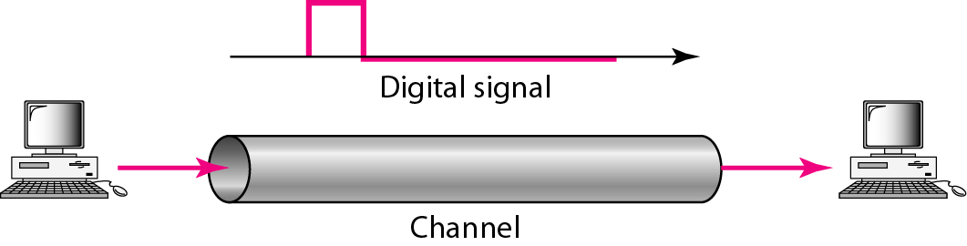
Figure 0.18 Baseband transmission

Slide 118
0.3.4 Transmission of Digital Signal
Baseband transmission requires that we have a low-pass channel, a channel with a bandwidth that starts from zero.
This is the case if we have a dedicated (专用的) medium with a bandwidth constituting only one channel.
For example, the entire bandwidth of a cable connecting two computers is one single channel.

Slide 119
0.3.4 Transmission of Digital Signal
As another example, we may connect several computers to a bus, but not allow more than two stations to communicate at a time.
Again we have a low-pass channel, and we can use it for baseband communication.
Figure 0.20 shows two low-pass channels: one with a narrow bandwidth and the other with a wide bandwidth.

Slide 120
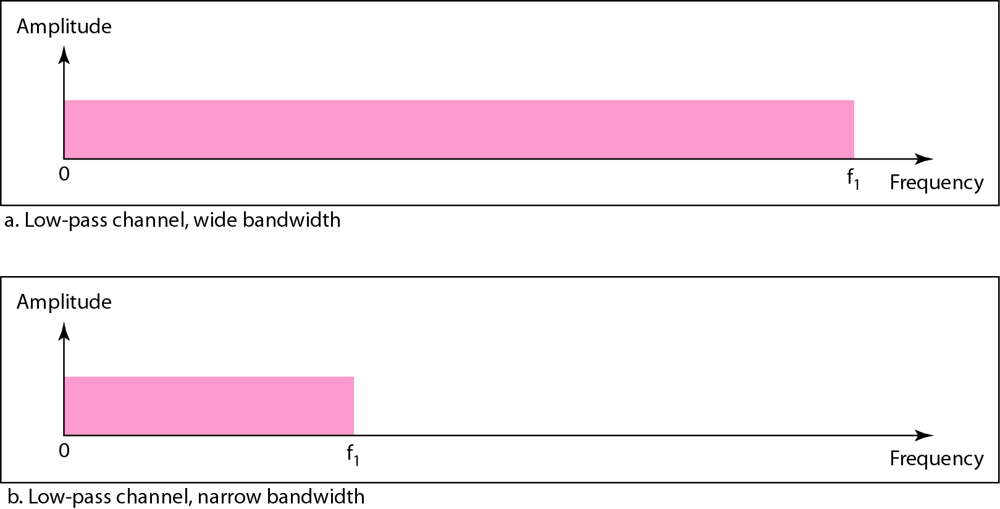
Figure 0.19 Bandwidths of two low-pass channels
Notes:
We need to remember that a low-pass channel with infinite bandwidth is ideal, but we cannot have such a channel in real life.
However, we can get close.

Slide 121
0.3.4 Transmission of Digital Signal
We need to remember that a low-pass channel with infinite bandwidth is ideal, but we cannot have such a channel in real life.
However, we can get close.
Let us study two cases of a baseband communication: a low-pass channel with a wide bandwidth and one with a limited bandwidth.

Slide 122
Case 1: Low-Pass Channel with Wide Bandwidth
If we want to preserve the exact form of a nonperiodic digital with vertical segments vertical and horizontal segments horizontal,
we need to send the entire spectrum, the continuous ranges of frequencies between zero and infinity.
This is possible if we have a dedicated medium with an infinite bandwidth between the sender and receiver that preserves (保持) the exact amplitude of each component of the composite signal.

Slide 123
Case 1: Low-Pass Channel with Wide Bandwidth
Although this may be possible inside a computer (e.g., between CPU and memory), it is not possible between two devices.
Fortunately, the amplitudes of the frequencies at the border of the bandwidth are so small that they can be ignored.
This means that if we have a medium, such as a coaxial cable or fiber optic, with a very wide bandwidth, two stations can communicate by using digital signals with very good accuracy (精确度), as shown in Figure 0.20.

Slide 124
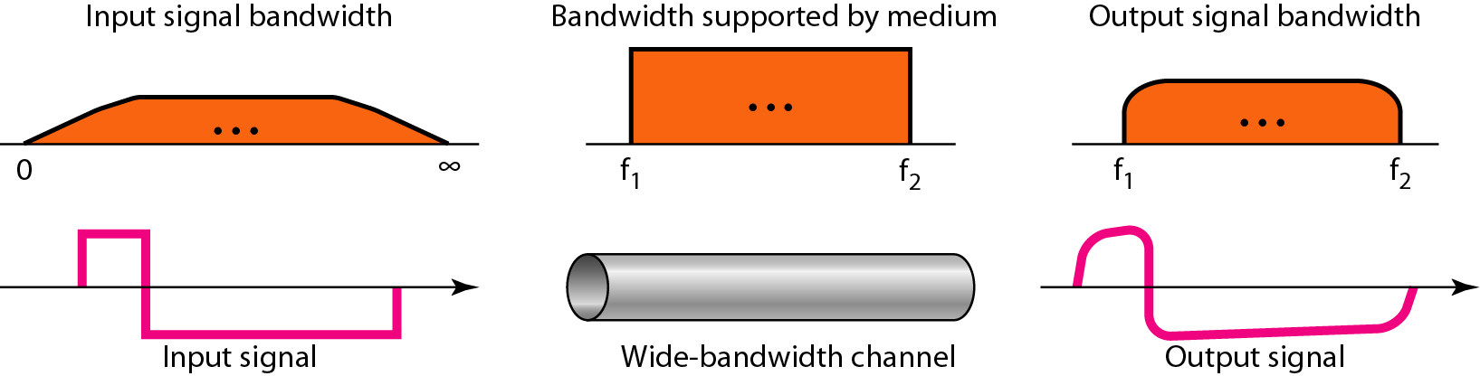
Figure 0.20 baseband transmission using a dedicated medium
required bandwidth (effective B.W guaranteeing no distortion) ＜ theoretical maximum bandwidth that a digital signal contains
available bandwidth supported by channel ≥ required bandwidth for signal
required/effective B.W ≤ available B.W ＜ theoretical B.W
Notes:
available bandwidth supported by channel(low-pass or bandpass)﹥required bandwidth for signal (effective B.W guaranteeing no distortion)
required bandwidth ＜theoretical maximum bandwidth for a digital signal.

Slide 125
Case 1: Low-Pass Channel with Wide Bandwidth
Note that f₁ is close to zero, and f₂ is very high.
Although the output signal is not an exact replica (精确的复制品) of the original signal, the data can still be deduced from the received signal.
Note that although some of the frequencies are blocked by the medium, they are not critical [决定性的].

Slide 126
Note
Baseband transmission of a digital signal that preserves the shape of the digital signal is possible only if we have a low-pass channel with an infinite or very wide bandwidth.

Slide 127
Example 0.21
An example of a dedicated channel (专用信道) where the entire bandwidth of the medium is used as one single channel is a LAN.
Almost every wired LAN today uses a dedicated channel for two stations communicating with each other.

Slide 128
Example 0.21
绞合线 类别 | 带宽 | 线缆特点 | 典型应用
3 | 16 MHz | 2对4芯双绞线 | 模拟电话；曾用于传统以太网
4 | 20 MHz | 4对8芯双绞线 | 曾用于令牌环局域网
5 | 100 MHz | 与4类相比增加了绞合度 | 传输速率不超过100 Mbit/s的应用
5E (超5类) | 100 MHz | 与5类相比衰减更小 | 传输速率不超过1 Gbit/s的应用
6 | 250 MHz | 与5类相比改善了串扰等性能 | 传输速率高于1 Gbit/s的应用
7 | 600 MHz | 使用屏蔽双绞线 | 传输速率高于10 Gbit/s的应用

Slide 129
Example 0.21
In a bus topology LAN with multipoint connections,
only two stations can communicate with each other at each moment in time (timesharing);
the other stations need to refrain from sending data.
In a star topology LAN, the entire channel between each station and the hub is used for communication between these two entities.

Slide 130
Case 2: Low-Pass Channel with Limited Bandwidth
In a low-pass with limited bandwidth, we approximate the digital signal with an analog signal.
The level of approximation depends on the bandwidth available.

Slide 131
1. Rough Approximation
Let us assume that we have a digital signal of bit rate N.
If we want to send analog signals to roughly simulate this signal, we need to consider the worst case, a maximum number of changes in the digital signal.
This happens when the signal carries the sequence 01010101… or the sequence 10101010… .
To simulate these two cases, we need an analog signal of frequency f = N/2.

Slide 132
1. Rough Approximation
Let 1 be the positive peak value and 0 be negative peak value.
We send 2 bits in each cycle.
However, just this one frequency cannot make (构成) all patterns; we need more components.
The maximum frequency is N/2.

Slide 133
1. Rough Approximation
As an example of this concept, let us see how a digital signal with a 3-bit pattern can be simulated by analog signals.
Figure 0.21 shows the idea.

Slide 134
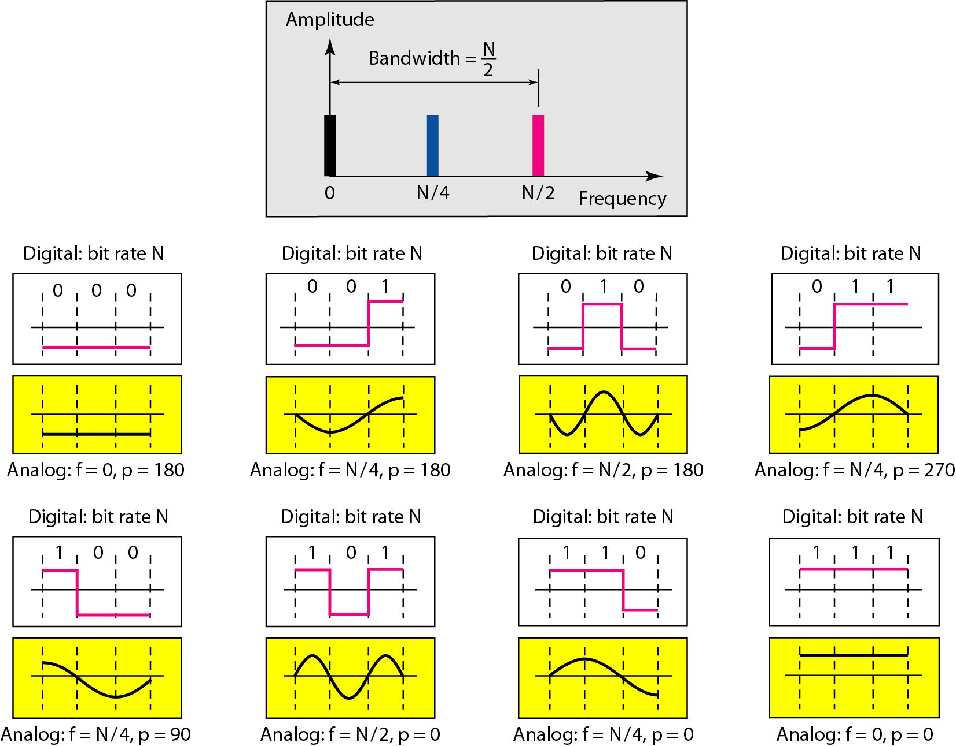
Figure 0.21 Rough approximation of a digital signal using
the first harmonic for the worst case

Slide 135
1. Rough Approximation
The two similar cases (000 and 111) are simulated with a signal with frequency f = 0 and a phase of 180⁰ for 000 and a phase of 0⁰ for 111.
The two worst cases (010 and 101) are simulated with an analog signal with frequency f = N/2 and a phase of 180⁰ and 0⁰ .
The other four cases can only be simulated with an analog signal with f=N/4 and phases of 180⁰ , 270⁰, 0⁰ and 0⁰.
In other words, we need a channel that can handle frequencies 0, N/4, and N/2.

Slide 136
1. Rough Approximation
This rough approximation is referred to as using the first harmonic (N/2) frequency.
The required bandwidth is
Bandwidth ＝ N/2 － 0 ＝ N/2

Slide 137
2. Better Approximation
To make the shape of the analog signal look more like that of a digital signal, we need to add more harmonics (谐波) of the frequencies.
We need to increase the bandwidth.
We can increase the bandwidth to 3N/2, 5N/2, 7N/2, and so on.
Figure 0.22 shows the effect of this increase for one of the worst cases, the pattern 010.
Notes:
谐波

Slide 138
Figure 0.22 Simulating a digital signal with first three harmonics

Slide 139
Simulating a digital signal with harmonics
Simulating a digital signal with first one harmonic
Simulating a digital signal with first three harmonics

Slide 140
2. Better Approximation
Note that we have shown only the highest frequency for each harmonic.
We use the first, third, and fifth harmonics.
The required bandwidth is now 5N/2, the difference between the lowest frequency 0 and the highest frequency 5N/2.
As we emphasized before, we need to remember that the required bandwidth is proportional to the bit rate.

Slide 141
常用的绞合线的类别、带宽和典型应用
绞合线 类别 | 带宽 | 线缆特点 | 典型应用
3 | 16 MHz | 2对4芯双绞线 | 模拟电话；曾用于传统以太网
4 | 20 MHz | 4对8芯双绞线 | 曾用于令牌环局域网
5 | 100 MHz | 与4类相比增加了绞合度 | 传输速率不超过100 Mbit/s的应用
5E (超5类) | 100 MHz | 与5类相比衰减更小 | 传输速率不超过1 Gbit/s的应用
6 | 250 MHz | 与5类相比改善了串扰等性能 | 传输速率高于1 Gbit/s的应用
7 | 600 MHz | 使用屏蔽双绞线 | 传输速率高于10 Gbit/s的应用

Slide 142
Note
In baseband transmission, the required bandwidth is proportional to the bit rate.
If we need to send bits faster, we need more bandwidth.

Slide 143
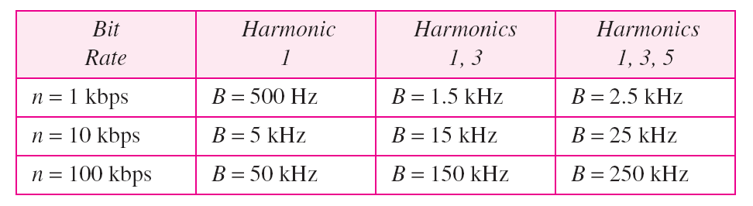
Table 0.2 Bandwidth requirements
By using this method, Table 0.2 shows how much bandwidth we need to send data at different rate.

Slide 144
Example 0.22
What is the required bandwidth of a low-pass channel if we need to send 1 Mbps by using baseband transmission?
Solution
The answer depends on the accuracy [精确度] desired.
a. The minimum bandwidth, is B = bit rate/2, or 500 kHz.
b. A better solution is to use the first and the third harmonics with B = 3×500 kHz = 1.5 MHz.
c. Still a better solution is to use the first, third, and fifth harmonics with B = 5×500 kHz = 2.5 MHz.

Slide 145
Example 0.23
We have a low-pass channel with bandwidth 100 kHz.
What is the maximum bit rate of this channel?
Solution
The maximum bit rate can be achieved if we use the first harmonic.
The bit rate is 2 times the available bandwidth, or 200 kbps.

Slide 146
2. Broadband Transmission (using modulation)
Broadband transmission or modulation means changing the digital signal to an analog signal for transmission.
Modulation allows us to use a bandpass channel — a channel with a bandwidth that does not start from zero.
This type of channel is more available than a low-pass channel.
Note that a low-pass channel can be considered a bandpass with the lower frequency starting at zero.

Slide 147
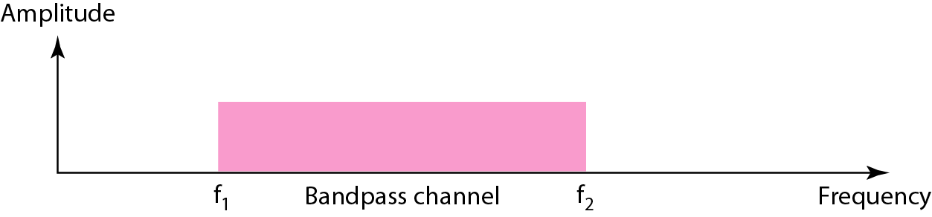
Figure 0.23 Bandwidth of a bandpass channel

Slide 148
Note
If the available channel is a bandpass channel, we cannot send the digital signal directly to the channel.
We need to convert the digital signal to an analog signal before transmission.

Slide 149
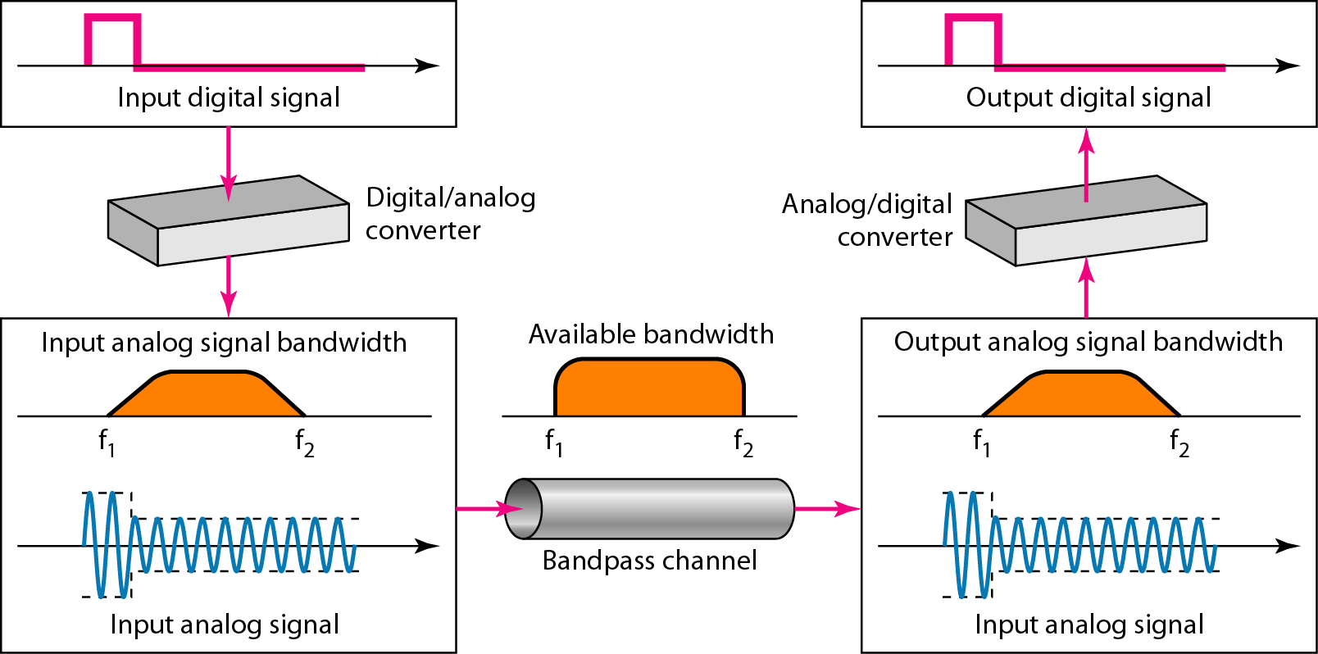
Figure 0.24 modulation of a digital signal for transmission on a bandpass channel
Notes:
ASK: S=N r=1 B=(1+d)S d∈[0,1)
FSK: S=N r=1 B=(1+d)S + 2△f d∈[0,1)
PSK: S=N r=1 B=(1+d)S d∈[0,1)
AM: B=2B
FM: B=2(1+β)B where β is a factor which depends on modulation technique with a common value of 4.
PM: B=2(1+β)B
Although, the formula, B=2(1+β)B, shows the same bandwidth for FM and PM, the value of b is lower in the case of PM (around 1 for narrowband and 3 for wideband).

Slide 150
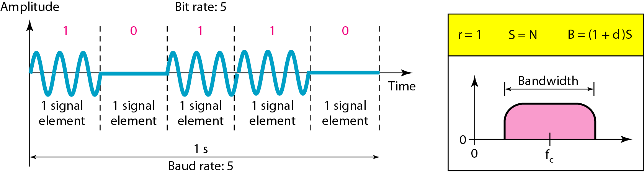
A Conceptual View of Binary ASK
The required bandwidth for analog transmission of digital data is proportional to the signal rate.
Figure Binary amplitude shift keying
Notes:
The required bandwidth for analog transmission of digital data is proportional to the signal rate.

Slide 151
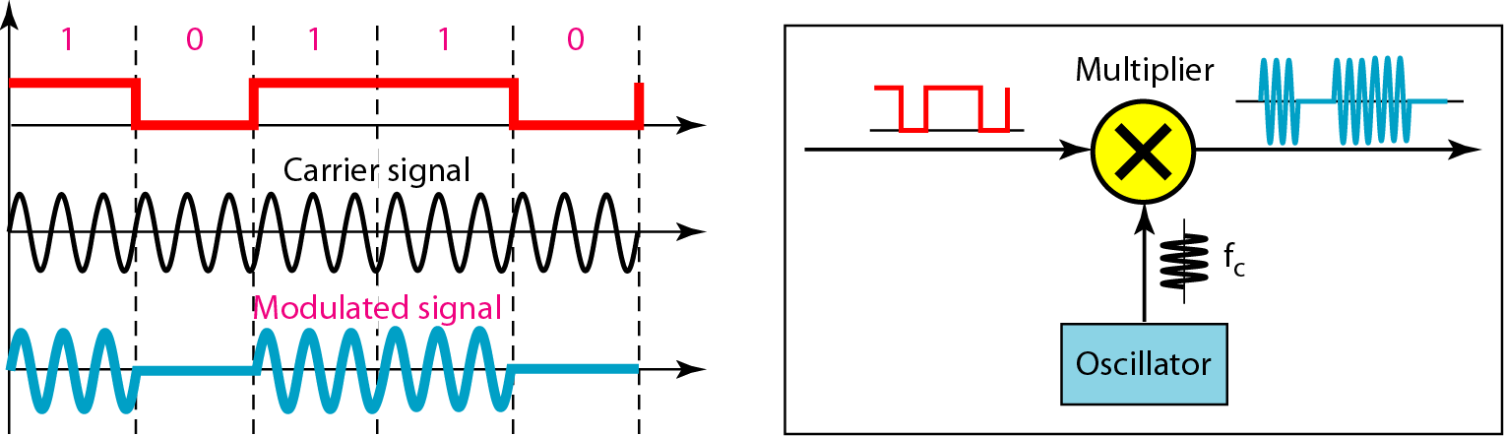
Implementation of Binary ASK
Unipolar NRZ (convert digital data to digital signals)
nonperiodic composite signal
Figure Implementation of binary ASK
Notes:
Unipolar NRZ (convert digital data to digital signals)

Slide 152
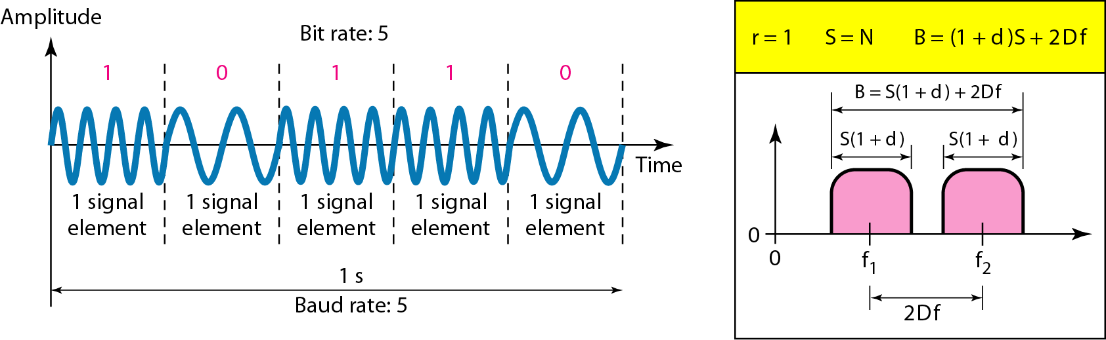
Binary frequency shift keying 二进制频率移动键控
coherent BFSK
Figure Binary frequency shift keying

Slide 153
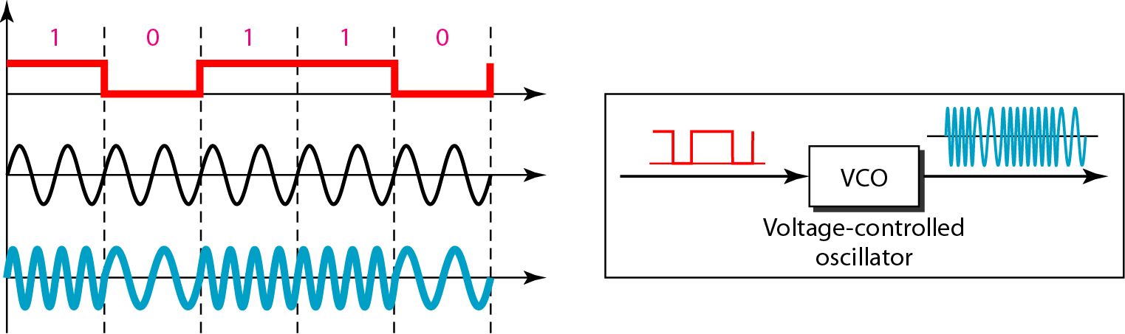
Implementation of BFSK
coherent BFSK
Figure Implementation of BFSK

Slide 154
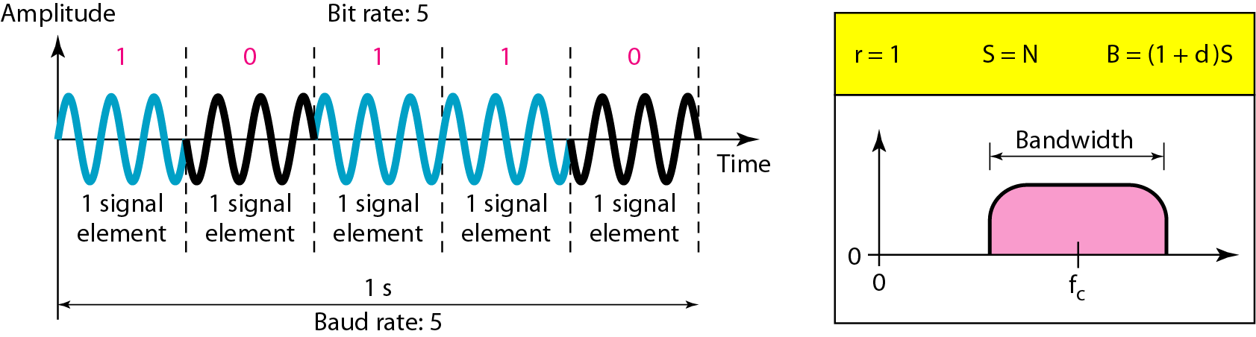
Binary phase shift keying

Slide 155
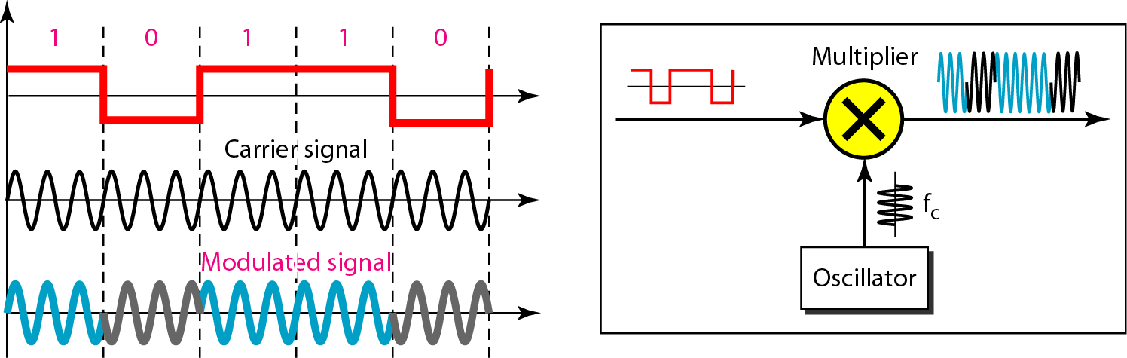
Implementation of BPSK
polar NRZ-L

Slide 156
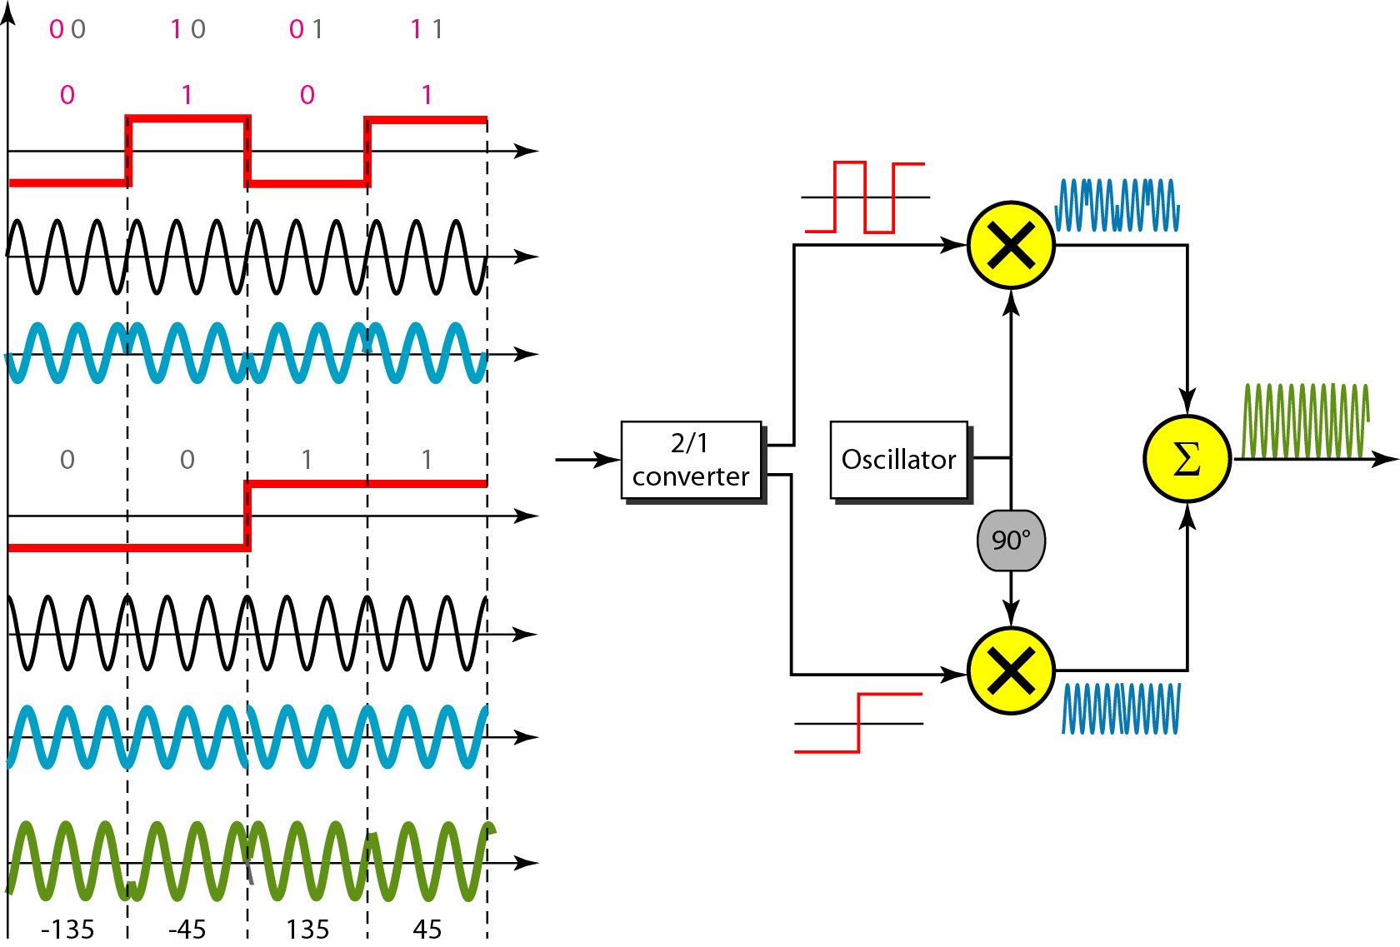
QPSK and its Implementation
0101
Polar NRZ-L
0: 180⁰
1: 0⁰
sigma
0: 270⁰
1: 90⁰
0011
00 10 01 11
Notes:
Polar NRZ-L

Slide 157
QPSK and its Implementation
modulated composite signal related to the bit pattern of 00:
modulated composite signal relative to the bit pattern of 11:

Slide 158
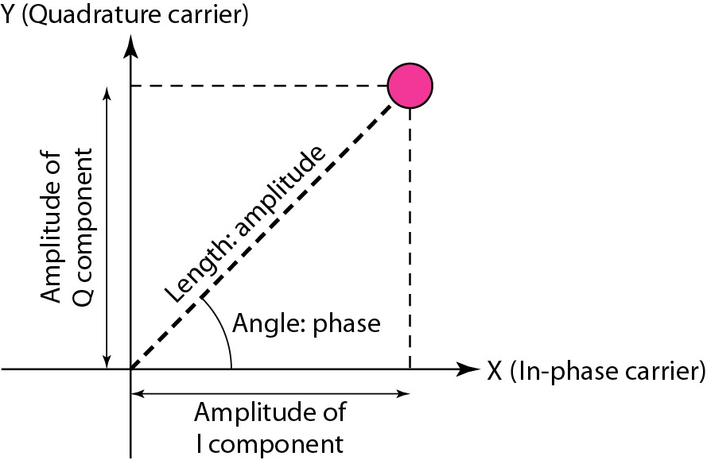
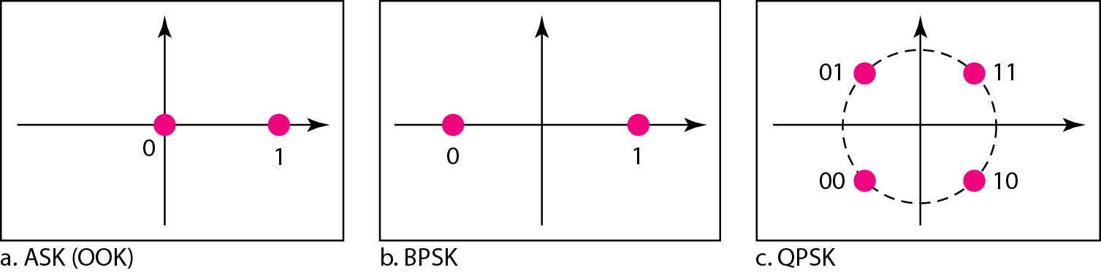
Three constellation diagrams
Notes:
OOK: On-Off Keying

Slide 159
Example 0.24
An example of broadband transmission using modulation is the sending of computer data through a telephone subscriber line, the line connecting a resident to the central telephone office.
These lines are designed to carry voice with a limited bandwidth (frequencies between 0 and 4 KHz).
Although this channel can be used as a low-pass channel, it is normally considered a bandpass channel. [FDM]
Broadband transmission

Slide 160
Example 0.24
We convert the digital signal from the computer to an analog signal, and send the analog signal.
We can install two converters to change the digital signal to analog and vice versa at the receiving end.
The converter, in this case, is called a modem (modulator /demodulator) which we discuss in detail in Chapter C00.

Slide 161
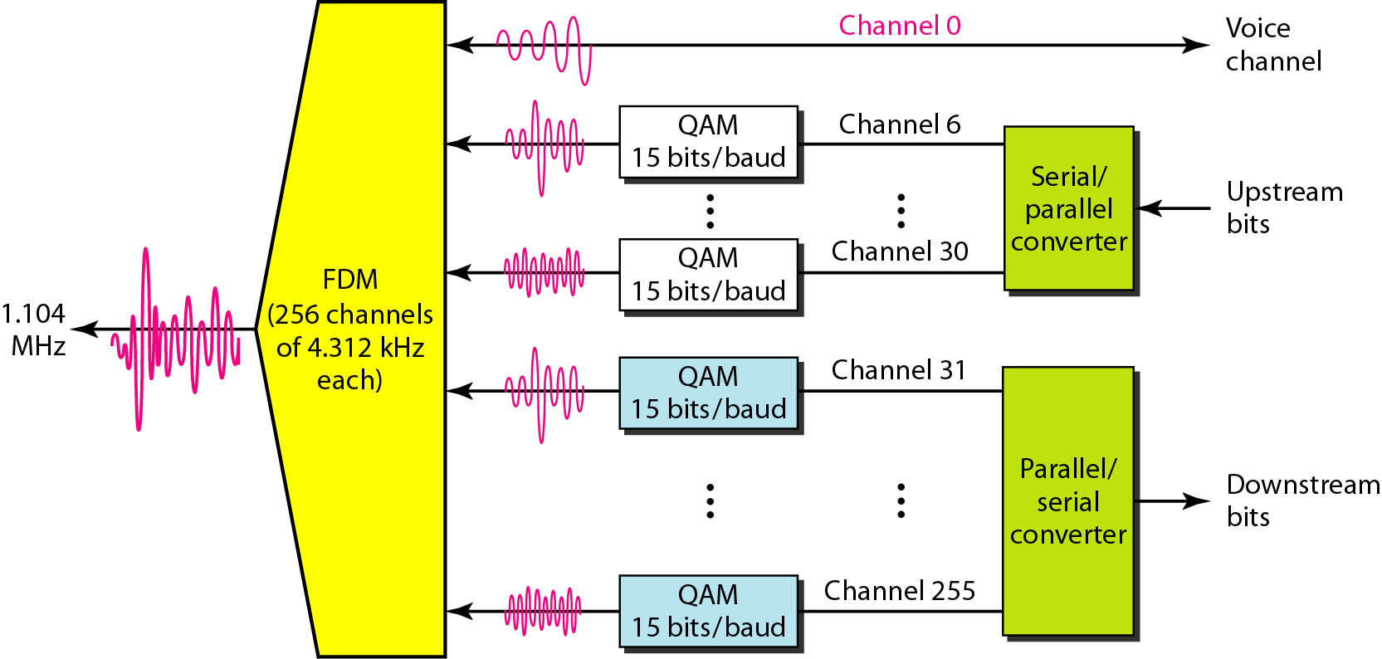
QAM in Discrete Multi-Tone Technique

Slide 162
Example 0.25
A second example is the digital cellular telephone.
For better reception, digital cellular phones convert the analog voice signal to a digital signal.
Although the bandwidth allocated to a company providing digital cellular phone service is very wide, we still cannot send the digital signal without conversion.

Slide 163
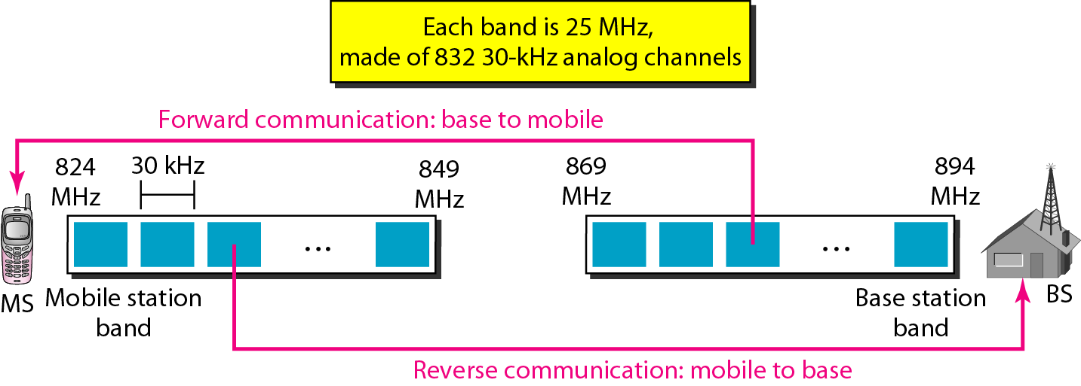
Cellular bands for AMPS
Notes:
Advanced Mobile Phone System

Slide 164
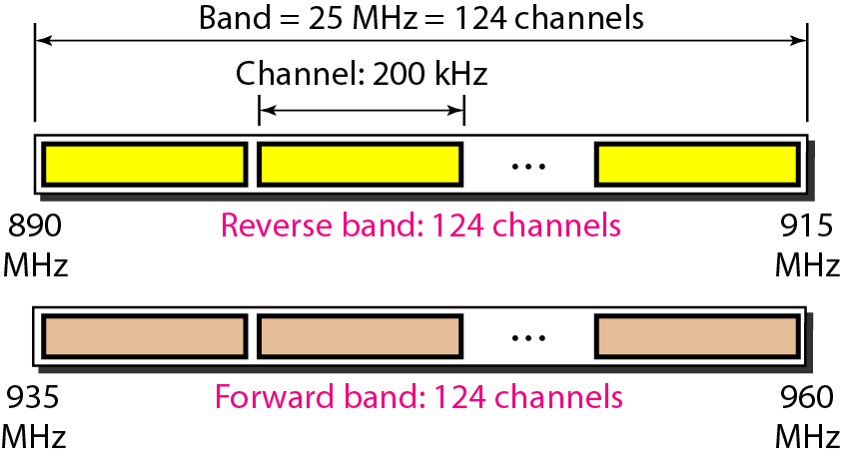
GSM bands (2G)
上行信道
下行信道
GSM uses two bands for duplex communication.
Each band is 25 MHz in width, and is divided into 124 channels of 200 kHz separated by guard bands.
Notes:
Data Communications and Networking 4th edition
The Global System for Mobile Communication (GSM) is a European standard that was developed to provide a common second-generation technology for all Europe.
The aim was to replace a number of incompatible first-generation technologies.
GSM uses two bands for duplex communication.
Each band is 25 MHz in width, shifted toward 900 MHz, as shown in Figure 16.7.
Each band is divided into 124 channels of 200 kHz separated by guard bands.

Slide 165
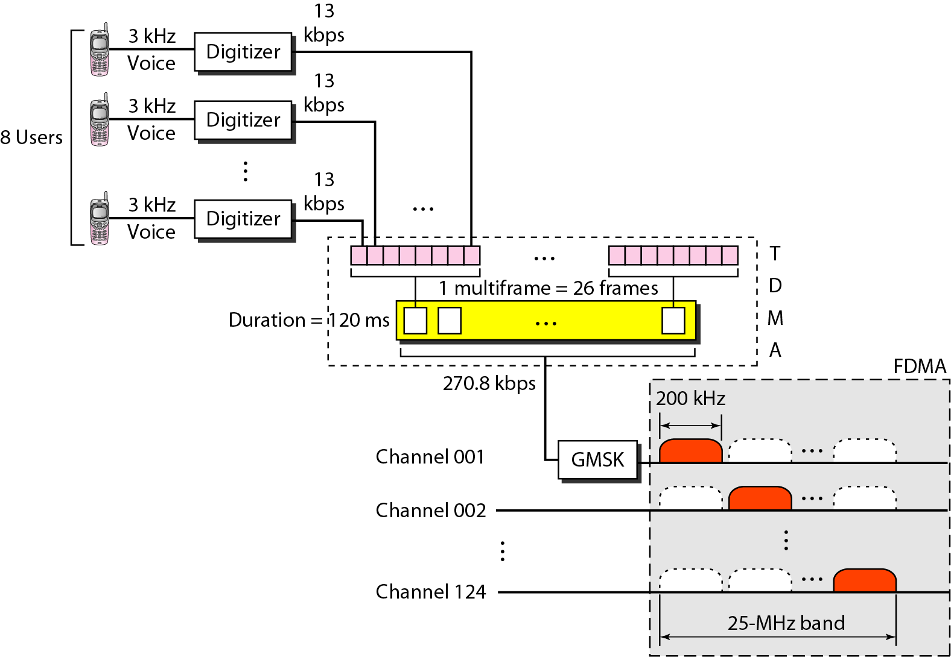
GSM
8 slots
The maximum number of cell phone subscriber: 124 channel×24 traffic frames * 8 users = 23808 users.
GMSK: Gaussian Filtered Minimum Shift Keying
Notes:
Data Communications and Networking 4th edition
Figure 16.8 shows a GSM system.
Each voice channel is digitized and compressed to a 13-kbps digital signal.
Each slot carries 156.25 bits. 156.25 *8 = 1250 bits
Eight slots share a frame (TDMA).
We can calculate the bit rate of each channel as follows: Channel data rate = 156.25×8×26×(1/120 ms) = 270.8 kbps.
Each 270.8-kbps digital channel modulates a carrier using GMSK (a form of FSK used mainly in European system); the result is a 200-kHz analog signal.
Finally, 124 analog channels of 200 kHz are combined using FDMA.
The result is a 25-MHz band.
Figure 16.9 shows the user data and overhead in a multiframe.

Slide 166
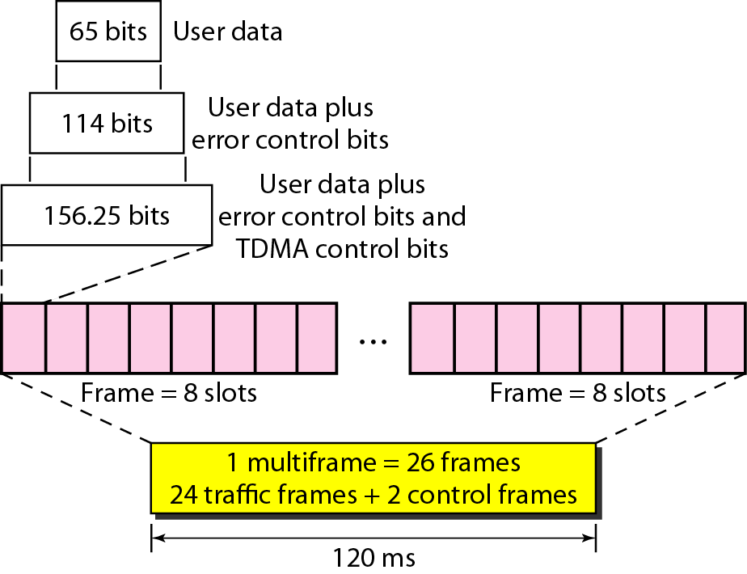
Figure multiframe components
_{13 kbps×(120 ms÷24) = 65 bit}
Eight slots are encapsulated in a frame (156.25×8 = 1250 bits).
user 1
user 8
Notes:
Data Communications and Networking 4th edition
The reader may have noticed the large amount of overhead in TDMA.
The user data are only 65 bits per slot. (13 kbps×(120 ms÷24) = 65 bit)
The system adds extra bits for error correction to make it 114 bits per slot.
To this, control bits are added to bring it up to 156.25 bits per slot.
Eight slots are encapsulated in a frame (156.25×8 = 1250 bits).
Twenty-four traffic frames and two additional control frames make a multiframe.
A multiframe has a duration of 120 ms.
However, the architecture does define superframes and hyperframes that do not add any overhead; we will not discuss them here.

Slide 167
Example 0.25
The reason is that we only have a bandpass channel available between caller and callee.
We need to convert the digitized voice to a composite analog signal before sending.
The digital cellular phones convert the analog audio signal to digital data and then convert it again to analog signal for transmission over a bandpass channel.

Slide 168
Chapter 00 Data and Signals
0.1 Analog and Digital
Analog and Digital Data
Analog and Digital Signal
Periodical and Nonperiodic Signals
0.2 Periodical Analog Signals
Sine Wave, Phase and Wavelength
Time and Frequency Domains
Composite Signals
Bandwidth
0.3 Digital Signals
0.4 Transmission Impairment
Attenuation, Distortion, and Noise
0.5 Data Rate Limits
Noiseless Channel: Nyquist Bit Rate
Noisy Channel: Shannon Capacity
Using Both Limits
0.6 Performance
Bandwidth
Throughput
Latency (Delay)
Bandwidth-Delay Product
Jitter

Slide 169
0.4 Transmission Impairment
Signals travel through transmission media, which are not perfect.
The imperfection causes signal impairment (减损).
This means that the signal at the beginning of the medium is not the same as the signal at the end of the medium.
What is sent is not what is received.
Three causes of impairment are attenuation, distortion, and noise.
Topics discussed in this section:
Attenuation
Distortion Noise

Slide 170

Figure 0.25 Causes of impairment

Slide 171
1. Attenuation
Attenuation [衰减] means a loss of energy.
When a signal, simple or composite, travels through a medium, it loses some of its energy in overcoming the resistance of the medium.
Figure 0.26 shows the effect of attenuation and amplification.

Slide 172

Figure 0.26 Attenuation

Slide 173
1. Attenuation
(1) Decibel
To show that a signal has lost or gained strength, engineers use the unit of the decibel.
The decibel (dB) measures the relative strengths of two signals or one signal at two different points.
dB = 10log₁₀ ^{(p2/p1)} .

Slide 174
0.4.1 Attenuation
Note that the decibel is negative if a signal is attenuated and positive if a signal is amplified.
Variables P₁ and P₂ are the powers of a signal at points 1 and 2, respectively.
Note that some engineering books define the decibel in terms of voltage instead of power.

Slide 175

Example 0.26
Suppose a signal travels through a transmission medium and its power is reduced to one-half.
This means that P2 is (1/2)P1 .
In this case, the attenuation (loss of power) can be calculated as
A loss of 3 dB (–3 dB) is equivalent to losing one-half the power.

Slide 176

Example 0.27
A signal travels through an amplifier, and its power is increased 10 times.
This means that P₂ = 10P₁.
In this case, the amplification (gain of power) can be calculated as

Slide 177
Example 0.28
One reason that engineers use the decibel to measure the changes in the strength of a signal is that decibel numbers can be added (or subtracted) when we are measuring several points (cascading, 串接) instead of just two.
In Figure 0.27 a signal travels from point 1 to point 4.
In this case, the decibel value can be calculated as

Slide 178


Example 0.28

Slide 179

Example 0.29
Sometimes the decibel is used to measure signal power in milliwatts.
In this case, it is referred to as dB_{m} and is calculated as dB_{m} = 10log₁₀^{Pm} , where P_{m} is the power in milliwatts.
Calculate the power of a signal if its dB_{m} = −30.
Solution
We can calculate the power in the signal as

Slide 180

Example 0.30
The loss in a cable is usually defined in decibels per kilometer (dB/km).
If the signal at the beginning of a cable with −0.3 dB/km has a power of 2 mW, what is the power of the signal at 5 km?
Solution
The loss in the cable in decibels is 5 × (−0.3) = −1.5 dB.
We can calculate the power as

Slide 181
0.4.2 Distortion
Distortion means that the signal changes its form or shape.
Distortion can occur in a composite signal made of different frequencies.
Each signal component has its own propagation speed through a medium and, therefore, its own delay in arriving at the final destination.

Slide 182

Figure 0.28 Distortion

Slide 183
0.4.2 Distortion
Differences in delay may create a difference in phase if the delay is not exactly the same as the period duration.
In other words, signal components at the receiver have phases different from what they had at the sender.

Slide 184
0.4.3 Noise
Noise is another cause of impairment. Several types of noise may corrupt the signal.
Thermal noise (热噪声) is the random motion of electrons in a wire which creates an extra signal not originally sent by the transmitter.
Induced noise comes from sources such as motors and appliances.
These devices act as a sending antenna, and the transmission medium acts as the receiving antenna.

Slide 185
0.4.3 Noise
Crosstalk is the effect of one wire on the other.
One wire acts as sending antenna and the other as the receiving antenna.
Impulse noise is a spike (a signal with high energy in a very short time) that comes from power line, lightening, and so on.

Slide 186

Figure 0.29 Noise

Slide 187
1. SNR
As we will see later, to find the theoretical bit rate limit, we need to know the ratio of the signal power to the noise power.
The signal-to-noise ratio is defined as:
SNR= (average signal power)/(average noise power)
We need to consider the average signal power and average signal noise power because these may change with time.
Figure 0.30 shows the idea of SNR.

Slide 188

Figure 0.30 Two cases of SNR: a high SNR and a low SNR

Slide 189
1. SNR
SNR is actually the ratio of what is wanted (signal) to what is not wanted (noise).
A high SNR means the signal is less corrupted by noise.
Because SNR is the ratio of two powers, it is often described in decibel units, SNR_{db}, defined as SNR_{db} = 10log₁₀^{SNR}.

Slide 190
Example 0.32
The values of SNR and SNRdB for a noiseless channel are
We can never achieve this ratio in real life; it is an ideal.

Slide 191
Chapter 00 Data and Signals
0.1 Analog and Digital
Analog and Digital Data
Analog and Digital Signal
Periodical and Nonperiodic Signals
0.2 Periodical Analog Signals
Sine Wave, Phase and Wavelength
Time and Frequency Domains
Composite Signals
Bandwidth
0.3 Digital Signals
0.4 Transmission Impairment
Attenuation, Distortion, and Noise
0.5 Data Rate Limits
Noiseless Channel: Nyquist Bit Rate
Noisy Channel: Shannon Capacity
Using Both Limits
0.6 Performance
Bandwidth
Throughput
Latency (Delay)
Bandwidth-Delay Product
Jitter

Slide 192
0.5 Data Rate Limits
A very important consideration in data communications is how fast we can send data, in bits per second, over a channel.
Data rate depends on three factors:
1. The bandwidth available
2. The level of the signals we use
3. The quality of the channel (the level of noise)
Topics discussed in this section:
Noiseless Channel: Nyquist Bit Rate Noisy Channel: Shannon Capacity Using Both Limits

Slide 193
0.5.1 Noiseless Channel: Nyquist Bit Rate
For a noiseless channel, the Nyquist (奈奎斯特) bit rate formula defines the theoretical maximum bit rate
According to the formula, we might think that, given a specific bandwidth available, we can have any bit rate by increasing the number of signal levels.
Although the idea is theoretically correct, practically there is a limit.

Slide 194
0.5.1 Noiseless Channel: Nyquist Bit Rate
When we increase the number of the signal levels, we impose a burden on the receiver.
If the level of a signal is 64, the receiver must be very sophisticated to distinguish between 64 different levels.
In other words, increasing the levels of a signal may reduce the reliability of the system.

Slide 195
Example 0.33
Does the Nyquist theorem bit rate agree with the intuitive bit rate (N=2f) described in baseband transmission?
Solution
They match when we have only two levels.
We said, in baseband transmission, the bit rate is 2 times the bandwidth if we use only the first harmonic in the worst case. (f=½N)

Slide 196
Example 0.33
However, the Nyquist formula is more general than what we derived intuitively.
It can be applied to baseband transmission and modulation.
Also, it can be applied when we have two or more levels of signals.

Slide 197
Example 0.34
Consider a noiseless channel with a bandwidth of 3000 Hz transmitting a signal with two signal levels.
The maximum bit rate can be calculated as

Slide 198
Example 0.36
We need to send 265 kbps over a noiseless channel with a bandwidth of 20 kHz.
How many signal levels do we need?
Solution
We can use the Nyquist formula as shown:

Slide 199
Example 0.36
Since this result is not a power of 2, we need to either increase the number of levels or reduce the bit rate.
If we have 128 levels, the bit rate is 280 kbps.
If we have 64 levels, the bit rate is 240 kbps.

Slide 200
0.5.2 Noisy Channel: Shannon Capacity
In reality, we cannot have a noiseless channel;
the channel is always noisy.
In 1944, Claude Shannon introduced a formula, called the Shannon capacity, to determine the theoretical highest data rate for a noisy channel:
Capacity = Bandwidth x log₂ (1 + SNR)

Slide 201
0.5.2 Noisy Channel: Shannon Capacity
Note that in the Shannon formula there is no indication of level,
which means that no matter how many levels we have, we cannot achieve a data rate higher than the capacity of the channel.
In other words, the formula defines a characteristic of the channel, not the method of transmission.

Slide 202
Example 0.37
Consider an extremely noisy channel in which the value of the signal-to-noise ratio is almost zero.
In other words, the noise is so strong that the signal is faint. For this channel the capacity C is calculated as
This means that the capacity of this channel is zero regardless of the bandwidth.
In other words, we cannot receive any data through this channel.

Slide 203
Example 0.38
We can calculate the theoretical highest bit rate of a regular telephone line.
A telephone line normally has a bandwidth of 3000Hz (300 to 3300Hz) assigned for data communications.
The signal-to-noise ratio is usually 3162.
For this channel the capacity is calculated as

Slide 204
Example 0.38
This means that the highest bit rate for a telephone line is 34.860 kbps.
If we want to send data faster than this, we can either increase the bandwidth of the line or improve [ameliorate] the signal-to-noise ratio.

Slide 205
Example 0.39
The signal-to-noise ratio is often given in decibels.
Assume that SNR_{dB} = 36 and the channel bandwidth is 2 MHz.
The theoretical channel capacity can be calculated as

Slide 206


Example 0.40
For practical purposes, when the SNR is very high, we can assume that SNR + 1 is almost the same as SNR.
In these cases, the theoretical channel capacity can be simplified to
For example, we can calculate the theoretical capacity of the previous example as

Slide 207
Chapter 00 Data and Signals
0.1 Analog and Digital
Analog and Digital Data
Analog and Digital Signal
Periodical and Nonperiodic Signals
0.2 Periodical Analog Signals
Sine Wave, Phase and Wavelength
Time and Frequency Domains
Composite Signals
Bandwidth
0.3 Digital Signals
0.4 Transmission Impairment
Attenuation, Distortion, and Noise
0.5 Data Rate Limits
Noiseless Channel: Nyquist Bit Rate
Noisy Channel: Shannon Capacity
Using Both Limits
0.6 Performance
Bandwidth
Throughput
Latency (Delay)
Bandwidth-Delay Product
Jitter

Slide 208
0.5.3 Using Both Limits
In practice, we need to use both methods to find the limits and signal levels.
Let us show this with an example.
We have a channel with a 1-MHz bandwidth. The SNR for this channel is 63.
What are the appropriate bit rate and signal level?
Solution
First, we use the Shannon formula to find the upper limit.

Slide 209
Example 0.41 (continued)
The Shannon formula gives us 6 Mbps, the upper limit.
For better performance we choose something lower, 4 Mbps, for example.
Then we use the Nyquist formula to find the number of signal levels.

Slide 210
Note
The Shannon capacity gives us the upper limit; the Nyquist formula tells us how many signal levels we need.

Slide 211
Chapter 00 Data and Signals
0.1 Analog and Digital
Analog and Digital Data
Analog and Digital Signal
Periodical and Nonperiodic Signals
0.2 Periodical Analog Signals
Sine Wave, Phase and Wavelength
Time and Frequency Domains
Composite Signals
Bandwidth
0.3 Digital Signals
0.4 Transmission Impairment
Attenuation, Distortion, and Noise
0.5 Data Rate Limits
Noiseless Channel: Nyquist Bit Rate
Noisy Channel: Shannon Capacity
Using Both Limits
0.6 Performance
Bandwidth
Throughput
Latency (Delay)
Bandwidth-Delay Product
Jitter

Slide 212
0.6 Performance
One important issue in networking is the performance of the network — how good is it?
We discuss quality of service, an overall measurement of network performance, in greater detail in Chapter 24.
In this section, we introduce terms that we need for future chapters.
Topics discussed in this section:
Bandwidth
Throughput Latency (Delay)
Bandwidth-Delay Product

Slide 213
0.6.1 Bandwidth
One characteristic that measures network performance is bandwidth.
However, the term can been used in two different contexts with two different measuring values:
The first, bandwidth in hertz, refers to the range of frequencies contained in a composite signal or the range of frequencies that a channel can pass.
For example, we can say the bandwidth of a subscriber telephone is 4 kHz.

Slide 214
0.6.1 Bandwidth
The second, bandwidth in bits per second, refers to the speed of bit transmission in a channel or link, or even a network.
For example, one can say the bandwidth of a Fast Ethernet network (or the links in this network ) is a maximum of 100 Mbps.
This means that this network can send 100 Mbps.

Slide 215
Relationship
There is an explicit relationship between the bandwidth in hertz and bandwidth in bits per seconds.
Basically, an increase in bandwidth in hertz means an increase in bandwidth in bits per second.
The relationship depends on whether we have baseband transmission or transmission with modulation.
Notes:
There is an explicit (明确的；清楚的) relationship between the bandwidth in hertz and bandwidth in bits per seconds.
Basically, an increase in bandwidth in hertz means an increase in bandwidth in bits per second.
The relationship depends on whether we have baseband transmission or transmission with modulation.
We discuss this relationship in Chapters 4 and 5.

Slide 216
Note
In networking, we use the term bandwidth in two contexts.
The first, bandwidth in hertz, refers to the range of frequencies in a composite signal or the range of frequencies that a channel can pass.
The second, bandwidth in bits per second, refers to the speed of bit transmission in a channel or link.
Notes:
In networking, we use the term bandwidth in two contexts.
The first, bandwidth in hertz, refers to the range of frequencies in a composite signal or the range of frequencies that a channel can pass.
The second, bandwidth in bits per second, refers to the speed of bit transmission in a channel or link.

Slide 217
Example 0.42
The bandwidth of a subscriber line is 4 kHz for voice or data.
The bandwidth of this line for data transmission can be up to 56,000 bps using a sophisticated modem to change the digital signal to analog.

Slide 218
Example 0.43
If the telephone company improves the quality of the line and increases the bandwidth to 8 kHz, [这里讲的是没有使用ADSL技术，只是单纯使用voice frequency band]
we can send 112,000 bps by using the same technology as mentioned in Example 0.42.

Slide 219
0.6.2 Throughput
The throughput is a measure of how fast we can actually send data through a network.
Although, at first glance, bandwidth in bits per second and throughput seem the same, they are different.
A link may have a bandwidth of B bps, but we can only send T bps through this link with T always less than B.
In other words, the bandwidth is a potential measurement of a link; the throughput is an actual measurement of how fast we can send data.

Slide 220
0.6.2 Throughput
For example, we may have a link with a bandwidth of 1 Mbps,
but the devices connected to the end of the link may handle only 200 kbps.
This means that we cannot send more than 200 kbps through this link.

Slide 221

Example 0.44
A network with bandwidth of 10 Mbps can pass only an average of 12,000 frames per minute with each frame carrying an average of 10,000 bits.
What is the throughput of this network?
Solution
We can calculate the throughput as
The throughput is almost one-fifth of the bandwidth in this case.

Slide 222
0.6.3 Latency (Delay)
The latency or delay defines how long it takes for an entire message to completely arrive at the destination from the time the first bit is sent out from the source.
We can say that latency is made of four components:
propagation time,
transmission time,
queuing time and
processing delay.

Slide 223
1. Propagation time
Propagation time measures the time required for a bit to travel from the source to the destination.
Propagation time =(Distance)/(Propagation Speed)
The propagation speed of electromagnetic signals depends on the medium and on the frequency of the signal.
For example, in a vacuum, light is propagated with a speed of 3 x 10⁸ m/s.
It is lower in air; it is much lower in cable.

Slide 224
Example 0.45
What is the propagation time if the distance between the two points is 12,000 km?
Assume the propagation speed to be 2.4×10⁸ m/s in cable.
Solution
We can calculate the propagation time as
The example shows that a bit can go over the Atlantic Ocean in only 50 ms if there is a direct cable between the source and the destination.

Slide 225
2. Transmission time
In data communication we don’t send 1 bit, we send a message.
The first bit may take a time equal to the propagation time to reach its destination;
the last bit also may take the same amount of time.
However, there is a time between the first bit leaving the sender and the last bit leaving the sender.

Slide 226
2. Transmission time
The time required for transmission of a message depends on the size of the message and the bandwidth of channel.
Transmission Time = (Message Size)/Bandwidth

Slide 227
Example 0.46
What are the propagation time and the transmission time for a 2.5-kbyte message (an e-mail) if the bandwidth of the network is 1 Gbps?
Assume that the distance between the sender and the receiver is 12,000 km and that light travels at 2.4×10⁸m/s.
Solution
We can calculate the propagation and transmission time as shown on the next slide:

Slide 228

Example 0.46 (continued)
Note that in this case, because the message is short and the bandwidth is high, the dominant factor is the propagation time, not the transmission time.
The transmission time can be ignored.

Slide 229
Example 0.47
What are the propagation time and the transmission time for a 5-Mbyte message (an image) if the bandwidth of the network is 1 Mbps?
Assume that the distance between the sender and the receiver is 12,000 km and that light travels at 2.4×10⁸ m/s.
Solution
We can calculate the propagation and transmission times as shown on the next slide.

Slide 230
Example 0.47 (continued)
Note that in this case, because the message is very long and the bandwidth is not very high, the dominant factor is the transmission time, not the propagation time.
The propagation time can be ignored.

Slide 231
3. Queuing time
The third component in latency is the queuing time, the time needed for each intermediate or end device to hold the message before it can be processed.
The queuing time is not a fixed factor; it changes with the load imposed on the network.
When there is heavy traffic on the network, the queuing time increases.

Slide 232
3. Queuing time
An intermediate device, such as a router, queues the arrived message and processes them one by one.
If there are many messages, each message will have to wait.

Slide 233
Four sources of packet delay
1. nodal processing:
check bit errors
determine output link
2. queuing
time waiting at output link for transmission
depends on congestion level of router
transmission
A
propagation
B
nodal
processing
queueing
Notes:
分组经过一个节点处理，到达下一个节点的过程中，经历的延迟主要有四种：
1、nodal processing delay(处理延迟):指路由器/交换机检查分组头部来决定从哪个输出端口转发所需的时间。节点处理延迟也可能包括检查分组是否出现错误所需的时间。经过处理延迟后，分组被缓存到队列中。
2、queuing delay(排队延迟): 分组等待输出链路空闲所需的时间。即从分组到达时可开始到分组离开时的时间差。分组所经历的排队延迟取决于队列中已有的分组的总长度和队列策略。

Slide 234

Output port queueing
Notes:
Output port queuing is illustrated in Figure 4.10.
At time t, a packet has arrived at each of the incoming input ports, each destined for the uppermost outgoing port.
Assuming identical line speeds and a switch operating at three times the line speed, one time unit later (that is, in the time needed to receive or send a packet), all three original packets have been transferred to the outgoing port and are queued awaiting transmission.
In the next time unit, one of these three packets will have been transmitted over the outgoing link.
In our example, two new packets have arrived at the incoming side of the switch; one of these packets is destined for this uppermost output port.

Slide 235

Notes:
Figure 4.11 shows an example in which two packets (darkly shaded) at the front of their input queues are destined for the same upper-right output port.
Suppose that the switch fabric chooses to transfer the packet from the front of the upper-left queue.
In this case, the darkly shaded packet in the lower-left queue must wait.
But not only must this darkly shaded packet wait, so too must the lightly shaded packet that is queued behind that packet in the lower-left queue, even though there is no contention for the middle-right output port (the destination for the lightly shaded packet).
This phenomenon is known as head-of-the-line (HOL) blocking in an input-queued switch — a queued packet in an input queue must wait for transfer through the fabric (even though its output port is free) because it is blocked by another packet at the head of the line.
[Karol 1987] shows that due to HOL blocking, the input queue will grow to unbounded length (informally, this is equivalent to saying that significant packet loss will occur) under certain assumptions as soon as the packet arrival rate on the input links reaches only 58 percent of their capacity.
A number of solutions to HOL blocking are discussed in [McKeown 1997b].

Slide 236
Delay in packet-switched networks
3. Transmission delay:
R = link bandwidth (bps)
L = packet length (bits)
time to send bits into link = L/R
4. Propagation delay:
d = length of physical link
s = propagation speed in medium (~2x10⁸ m/sec)
propagation delay = d/s
Note: s and R are very different quantities !
transmission
A
propagation
B
nodal
processing
queueing

Slide 237

Caravan analogy
100 km
100 km
ten-car
caravan
toll
booth
toll
booth
cars “propagate” at 100 km/hr
toll booth takes 12 sec to service car (transmission time)
car ~ bit; caravan ~ packet
Q: How long until caravan is lined up before 2nd toll booth?
Time to “push” entire caravan through toll booth onto highway = 12*10 = 120 sec
Time for last car to propagate from 1st to 2nd toll both: 100km/(100km/hr)= 1 hr
A: 62 minutes

Slide 238
四种时延所产生的地方
假设从结点 A 向结点 B 发送数据
在结点 A 中产生
处理时延和排队时延
在链路上产生
传播时延
在发送器产生传输时延
(即发送时延)
数据
1 0 1 1 0 0 1
…
队列
链路
结点 A
发送器
结点 B
几种时延产生的地方不一样
Notes:
238

Slide 239
0.6.4 Bandwidth-Delay Product
Bandwidth and delay are two performance metrics of a link.
However, as we will see in this chapter and future chapters, what is very important in data communications is the product of the two.
Let us elaborate on this issue, using two hypothetical cases as examples.

Slide 240

Figure 0.31 Filling the link with bits for case 1
Looking at the figure, we can say that this product 1×5 is the maximum number of bits that can fill the link.
There are no more than 5 bits at any time on the link.

Slide 241
Case 2
Now assume we have a bandwidth of 4 bps.
Figure 0.32 shows that there can be maximum 4 x 5 = 20 bits on the line.
The reason is that, at each second, there are 4 bits on the line; the duration of each bit is 0.25 s.

Slide 242

Figure 0.32 Filling the link with bits in case 2

Slide 243
0.6.4 Bandwidth-Delay Product
The above two cases show that the product of bandwidth and delay is the number of bits that can fill the link.
The measure is important if we need to
send data in bursts and
wait for the acknowledgement of each burst before sending the next one. (half-duplex channel ^{cz})

Slide 244
0.6.4 Bandwidth-Delay Product
To use the maximum capability of the link, we need to make the size of our burst 2 times the product of bandwidth and delay;
we need to fill up the full-duplex channel (two directions).

Slide 245
0.6.4 Bandwidth-Delay Product
The sender should send a burst of data of (2 x bandwidth x delay) bits.
Then the sender waits for receiver acknowledgement for part of the burst before sending another burst.
The amount 2 x bandwidth x delay is the number of bits that can be in transition at any time.

Slide 246
Note
The bandwidth-delay product defines the number of bits that can fill the link.

Slide 247

Example 0.48
We can think about the link between two points as a pipe.
The cross section of the pipe represents the bandwidth, and the length of the pipe represents the delay.
We can say the volume of the pipe defines the bandwidth-delay product, as shown in Figure 0.33.
Figure 0.33 Concept of bandwidth-delay product

Slide 248
0.6.5 Jitter
Another performance issue that is related to delay is jitter.
We can roughly say that jitter is a problem
if different packets of data encounter different delays
and the application using the data at the receiver site is time-sensitive (audio and video data, for example).
If the delay for the first packet is 20 ms, for the second is 45 ms, and for the third is 40 ms, then the real-time application that uses the packets endures jitter.

Slide 249
0.7 Summary
Data must be transformed to electromagnetic signals to be transmitted.
Data can be analog or digital.
Analog data are continuous and take on continuous values.
Digital data have discrete states and take discrete values.

Slide 250
0.7 Summary
Signals can be analog or digital.
Analog signals can have an infinite number of values in a range;
digital signals can have only a limited number of values.
In data communication, we commonly use periodic analog signals and nonperiodic digital signals.

Slide 251
0.7 Summary
Frequency and period is the inverse of each other. Frequency is the rate of change with respect to time.
Phase describes the position of the waveform relative to time 0.
A complete sine wave in the time domain can be represented by one single spike in the frequency domain.
A single-frequency sine wave is not useful in data communications; we need to send a composite signal, a signal made of many simple sine waves.

Slide 252
0.7 Summary
According to Fourier analysis, any composite signal is a combination of simple sine waves with different frequencies, amplitudes, and phases.
The bandwidth of a composite signal is the difference between the highest and the lowest frequencies contained in that signal.
A digital signal is a composite analog signal with an infinite bandwidth.

Slide 253
0.7 Summary
Baseband transmission of a digital signal that preserves the shape of the digital signal is possible only if we have a low-pass channel with an infinite or very wide bandwidth.
If the available channel is a bandpass channel, we cannot send a digital signal directly to the channel;
we need to convert the digital signal to an analog signal before transmission.

Slide 254
0.7 Summary
For noiseless channel, the Nyquist bit rate defines the theoretical maximum bit rate.
For a noisy channel, we need to use the Shannon capacity to find the maximum bit rate.
Attenuation, distortion, and noise can impair a signal.
Attenuation is the loss of a signal’s energy due to the resistance of the medium.

Slide 255
0.7 Summary
Distortion is the alternation of a signal due to the differing propagation speeds of each of the frequencies that make up a signal.
Noise is the external energy that corrupts a signal.
The bandwidth-delay product defines the number of bits that can fill the link.

Slide 256
Chapter 00 Data and Signals
0.1 Analog and Digital
Analog and Digital Data
Analog and Digital Signal
Periodical and Nonperiodic Signals
0.2 Periodical Analog Signals
Sine Wave, Phase and Wavelength
Time and Frequency Domains
Composite Signals
Bandwidth
0.3 Digital Signals
0.4 Transmission Impairment
Attenuation, Distortion, and Noise
0.5 Data Rate Limits
Noiseless Channel: Nyquist Bit Rate
Noisy Channel: Shannon Capacity
Using Both Limits
0.6 Performance
Bandwidth
Throughput
Latency (Delay)
Bandwidth-Delay Product
Jitter

